Slide 1
Community Paediatrics- sub-specialty overview and Grid application
Dr A. Hector 18.August 2020
Wessex Community Paediatric Grid Trainee, ST7

Slide 2
This talk is for…..
General Paediatric core trainees who want to make the most of their Community Core-training
General Paediatric core trainees considering sub-specialty training in Community Paediatrics
All core trainees considering a paediatric sub-specialty Grid application

Slide 3
Four areas of Community Paediatrics
Public Health
Neuro-disability
Developmental / Behavioural
Safeguarding

Slide 4
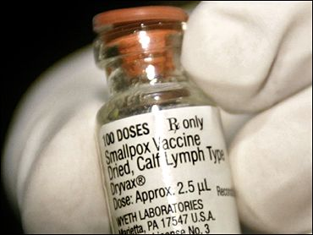
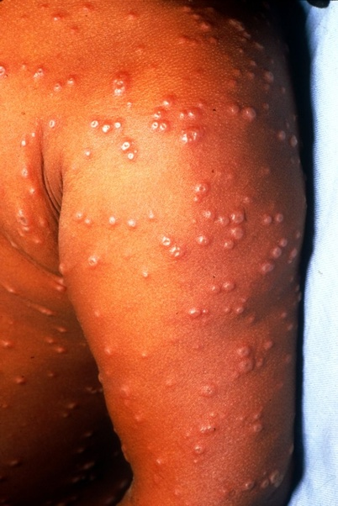
Public Health

Slide 5
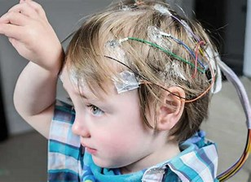
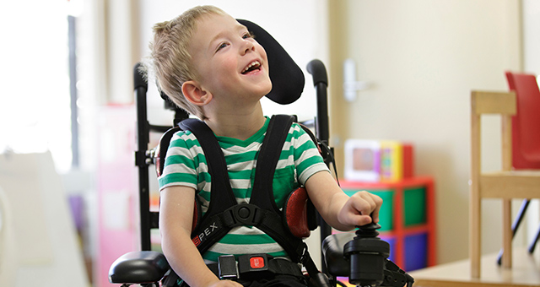
Neuro-disability

Slide 6
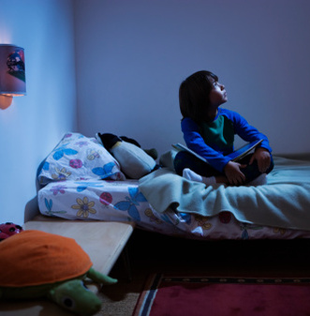
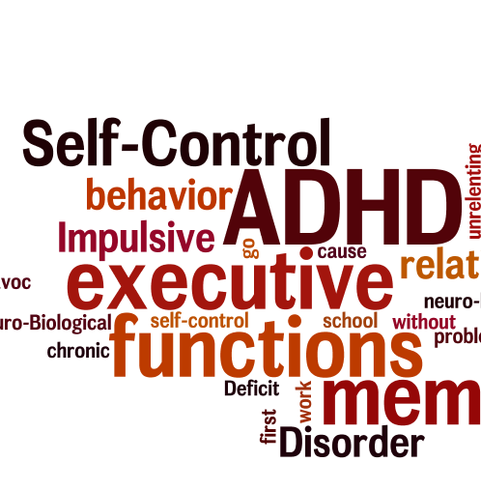
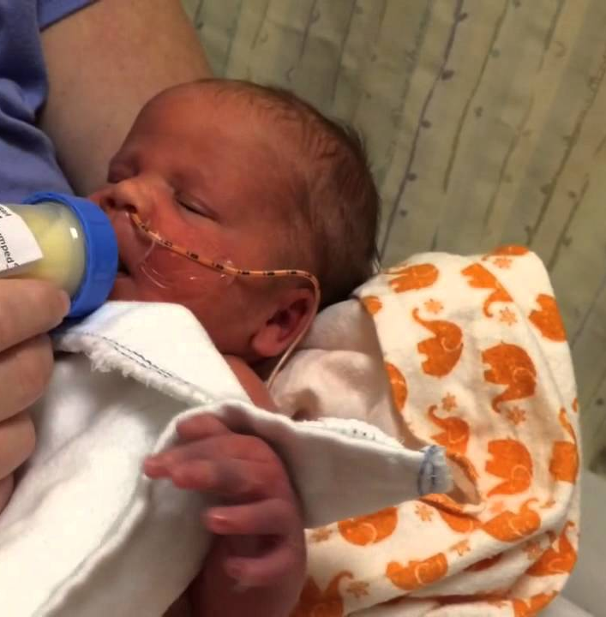
Developmental / Behavioural Paediatrics

Slide 7
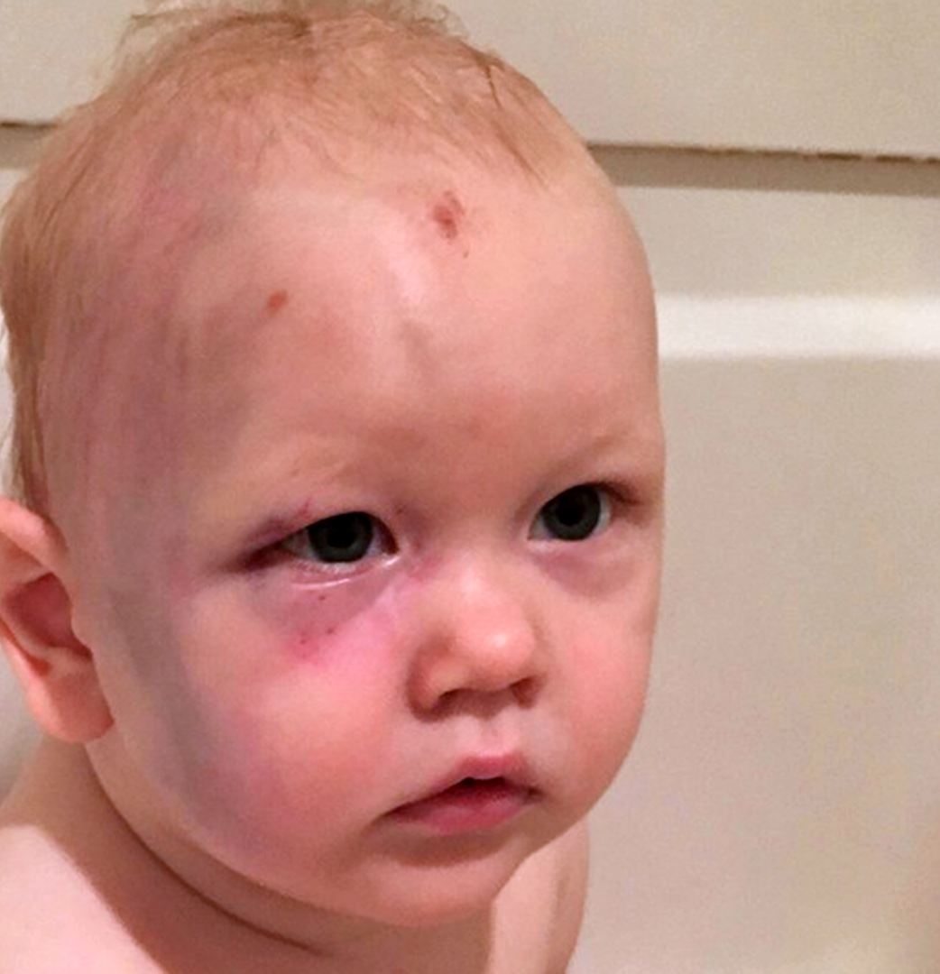
Safeguarding

Slide 8
General Paediatricians – core training I
Neuro-disability clinics
Special school clinics
TAC / MDT meetings
Cerebral palsy clinics
Down Syndrome clinics
Speech and language developmental assessments with SALT team

Slide 9
General Paediatricians – core training II
Audiology and visual assessment clinics
Follow MDT members (e.g. Physio, OT, Portage team, meet SENCO)
Palliative care – visit local hospice, ethics reflections
Safeguarding – shadow CP assessment in Magnolia centre or ED
LAC clinics
Adoption panel / pre-adoption assessment clinics

Slide 10
Could Community Paediatrics be right for me?

Slide 11
Which attitudes and character traits are useful?
Empathic and caring nature
Enjoyment to improve life quality
‘Holistic view’ approach
Team player but also able to work independently
Good communicator and networker
Dynamic and proactive
Sense of justice to feel motivated to advocate
Focused and organised - lots of admin!

Slide 12
Comparison of General- versus Community Paediatrics
CCH | General Paeds
Take your work home with you Patient ownership | Have to 'clock in' and 'clock out' at a set time Able to hand over
Flexible working Manage your own time | Work schedule dictated by on call Days very structured
Know patients and family over years | Hard to follow patient's journey Address a single problem
More time per patient Feels like you are covering everything! | Less time per patient (unless very sick)
Immediate answers not needed Learn lots about parenting – not taught in med school!: (behaviour, sleep, toileting, diet) really affects family's lives. No cure for most patients but helping to manage difficulties | Dealing with life/death situations Lots of admissions are 'curable
Isolating Have to 'look' for your team | More camaraderie based
Working with wide range of multi-agency: education and social care | Tend to work with hospital staff only
CCH/PND
Acute Paediatrics
Take your work home with you
Patient ownership
Can be quite isolating
Flexible working
Manage your own time
Know your patients and family over years
More time per patient
Immediate answers not needed
Have to 'clock in' and 'clock out' at a set time
Able to hand over
More 'camaraderie' based
Work schedule dictated by on call
Hard to follow a patient's journey
Days are very structured
Less time per patient (unless sick)
Can deal with life/death situations
Tend to work with hospital staff only
Lots of admissions are curable
Notes:
Thanks to Yan and Rebecca

Slide 13
Grid training Community Paediatrics
Usually a three years programme
at least 2 years training in community Paediatric training posts
1 year for co-specialties e.g. Neurology, Genetics, CAMHS, Public Health

Slide 15
Application process
Two step process – online application and interview
Be aware of timeline – short application window
Prepare eligibility form – Deanery must confirm
Person specification
Online application – via https://new.oriel.nhs.uk
Interview
Ranking and appoint ability
If Grid application does not work out:
there are alternative routes into Community Paediatrics!

Slide 16
Grid application Timeline
07.09.20 12:00
28.09.20 12:00
9th of November – 4th of December 2020
(specific dates will follow)
Online application period opens
Online application period closes
Virtual interviews planned

Slide 17
Person specification
Clinical experience
Management experience
Quality Improvement / Audit
Education involvement / teaching
Research achievements
Publications/ Presentations and posters
Statement to support application

Slide 18
Tips and examples
Audit/QI: Don’t need lots of projects, one or two good ones! Make sure you close the loop and demonstrate service improvement.
Management: Try to show activity e.g. rota co-ordinator, member of BMA local negotiation committee as Local Trust’s representative for LTFT Paediatric Trainees and presented trainee’s concerns (not just passively sitting in but also getting involved).
Posters/Presentations: Take every opportunity to submit a poster for annual conferences (also an opportunity to meet people!)
Research: Ask Catrina or other people where you can get involved! You do not need to get points in every section!!!

Slide 19
Interview example
Two stations:
Presentation (8 min)
‘How can your past achievements and strengths help to support a future career in Community Child Health?’
Questions for example:
Why Community Paediatrics?
Talk about evidence in your CV showing that you are able to contribute and improve services in the future
Demonstrate how you keep up to date and use evidence-based medicine
Two clinical scenarios

Slide 20
Useful Resources
Medical interviews book
Presentation tips: https://www.medical-interviews.co.uk/topic/medical-teaching-course-powerpoint-presentation-tips
Webinars & Trelloboards
BACCH
BPNA
BACD
https://www.bacch.org.uk/
https://bpna.org.uk/
https://www.bacdis.org.uk/

Slide 21
Numbers of 2019 Round
CCH 58 applications
3 unsuccessful at long / short list
55 interviewed
48 appointable
27 accepted offers
19 had first choice

Slide 22
Thank you!

