Slide 1
Paediatric renal trauma
James Austin
Foundation Year 2
Basingstoke & North Hampshire Hospital

Slide 2
Thanks to Mr Govindaraj Rajkumar

Slide 3
Paediatric renal trauma
Case Study
Long term complications

Slide 5
Case Study

Slide 6
BS
14yo boy
PMHx – constipation (age 6/12), mild asthma
DHx - nil

Slide 7
BS
14yo boy
Went up half pipe ramp on scooter
Front wheel landed on top of ramp and fell over
Unable to recall precise mechanism of landing
Returned home

Slide 8
BS
At home
Passed urine – blood seen!
Right sided abdo pain – worse if walk

Slide 9
BS
On arrival by ED consultant
RR 18, Sp 100%, BP 112/67, HR 86
Alert
Tender right flank
No guarding/peritonism
Blood on urethral meatus
Referred to surgeons

Slide 10
Features suggestive of significant renal trauma
There are no consistent features seen in all renal trauma
Mechanism can be relatively innocuous
Gross haematuria can occur with simple small haematomas
Therefore, low threshold to suspect!

Slide 11
BS
On call surgeons r/v
Bloods + venous gas
IVI
Urinary catheter
Bed rest
ITU r/v and on call urology contact
No urology contact for 3hrs!!

Slide 12
BS
Paediatrician, Urologist, ITU consultant and Surgical on call plan agreed
30 minute observations
4hrly venous gas for Hb and lactate
Tranexamic acid
IVABx
Transfuse Hb <90g/dl
Liaise with paediatric surgeons (UHS)

Slide 13
BS
Assessment overnight
Hb 133->121->118->122
Lactate remains 1.0-1.6mmol/L
Catheter drain dark urine with washout
Passing 62.5ml/hr (1.1ml/kg/hr)
Codeine/paracetamol improves pain
Creatinine 71

Slide 14
BS
Morning review (urology)
Clear urine
Hb 118-> 113
Urine 60ml/hr
Soft abdomen and not tender
HR 91, BP 98/55, Sp 99% on air
USS arranged
Creatinine 71-> 67

Slide 15
USS KUB – perinephric haematoma of right kidney with possible small laceration
CT KUB is organised

Slide 16
CT KUB – comminuted fracture of waist of right kidney extending to lower pole and pelvicalyceal system
Grade IV injury

Slide 18
AAST grading
Grades 1-5 – increasing severity
Higher grades -> more likely surgical intervention

Slide 20
Day 3-4
Temp 37.5-37.9’C, HR 100-110
Cultures taken
Hb 108, WCC 15.1, CRP 54
on IV ceftriaxone
Microbiology -> add metronidazole, ?infected haematoma
CT angiogram performed

Slide 21
CT angiogram -
no extravasation
But note contrast entering perinephric haematoma -> suggest communication with the urinary system
Generalised fluid in the abdomen -> ?pneumoperitoneum

Slide 23
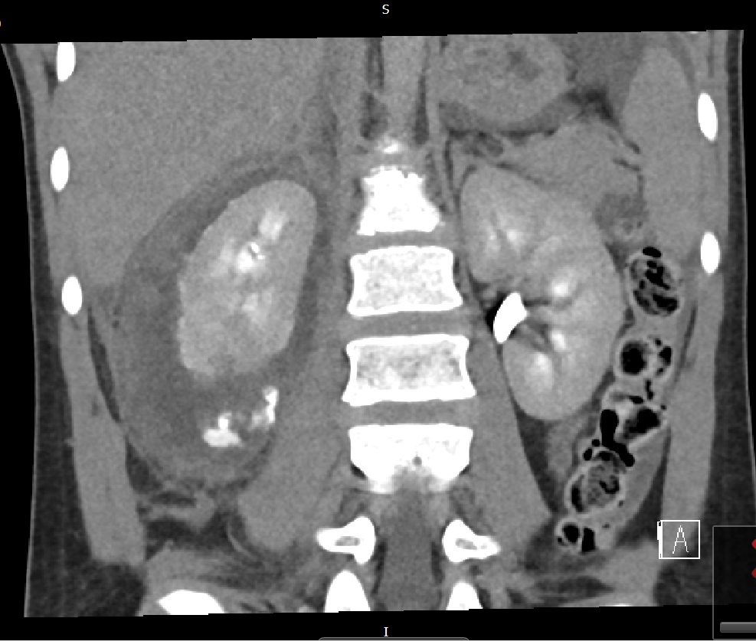

Slide 24
Day 5
Cystoscopy and right ureteric stent placed

Slide 26
Day 6-8
Continuing fevers
Cultures negative, CRP 110, Hb 108
But feels well
Discharged with oral amoxicillin and repeat USS KUB
Suggested that fevers-> resolving haematoma

Slide 27
Post discharge
2/52 – repeat USS shows resolving collection
3/52 – stent removed
4/52 – new abdo pain, seen by urology but resolves
5/52 – DNA to OPA

Slide 28
Post discharge
3/12 – OP clinic -> occasional pain but well, Hb 145, Creatinine 57
6/12 – USS – fully resorbed haematoma, irregular contour suggesting cortical scarring
7/12 – OP clinic -> DNA -> discharged from urology with no further follow up.

Slide 29
Complications of renal trauma

Slide 30
Paediatric anatomy
Kidneys lower in abdomen
flayed rib cage
Less perinephric fat/support
thinner blood vessels
thinner abdominal musculature
-> more prone to deceleration injury , falls etc

Slide 31
Acute complications
Urinoma
Haematoma
Retroperitoneal haemorrhage
Sepsis
Perinephric abscess
Pseudoaneurysm
Arteriovenous fistula
Acute kidney injury
Devitalised renal segment

Slide 32
Long term complications
Relatively little information available
Even less for paediatrics!

Slide 33
Post-trauma hypertension
Suggested 0-33% (average 5.2%) of patients
Occurs 37days – decades (average 34mths)
Linked
Severity
Renal artery occlusion
Grade 4/5 and vascular injuries -> advise BP check for years

Slide 34
Page kidney -> HTN secondary to compression renal parenchyma
Dogs and cellophane

Slide 35
Haematoma/fibrosis -> local ischaemia -> upregulated renin-angiotensin system -> HTN
Link to arteriovenous fistula/pseudoaneurysm/ devitalised tissue
Treat
Anti-hypertensives
stent/angioplasty/embolisation
Segment excision OR nephrectomy

Slide 36
Arteriovenous fistula
70% resolve
Penetrating trauma
Ongoing haematuria
Detect on renal scintigraphy
80% can have angiographic embolisation

Slide 37
Renal insufficiency
Unclear if a link, one studies report 6.4-16% with reduced function
DMSA renal scan -> 17 children at 2yrs, see 21%-55% residual function but normal BP/U&Es
Linked to severity of trauma

Slide 38
Renal calculus
Scarring or deformity of pelvicalyceal system
Allows a nidus for calculi formation
Chronic pyelonephritis
Hydronephrosis

Slide 39
Outlook
There is irreversible loss of function following trauma
Higher risk of chronic kidney disease in adulthood?
Higher risk of future hypertension?
No consensus on how to follow up patients – case by case

