Slide 1
TEAM JOY Dr Jennifer Livings, Carol Paterson, Dr Kate Pryde, Mrs Francesca Stedman
Notes:
Welcome to Team Joy,
1

Slide 2
a k a...
SPRINKLING GLITTER
Notes:
Also known as ‘sprinkling glitter’

Slide 3
Notes:
Team Joy came about as a result of participation in an institute for healthcare improvement course called finding and creating joy in work.
We each recognised in ourselves a real sense of enjoyment and satisfaction with the work that we do, and a desire for others to feel as enthusiastic as we do. We know that working in a healthcare setting can be stressful, exhausting, and at times thankless. But we would like to do what we can to recognise these factors, and where possible, improve things and therefore increase the levels of enjoyment, achievement and satisfaction that we feel at work.
So, this is why I want to do it! But we also know a happy and productive workforce means we are less likely to see employee turnover, and more likely to see improved patient outcomes (see IHI paper for specific references).

Slide 4
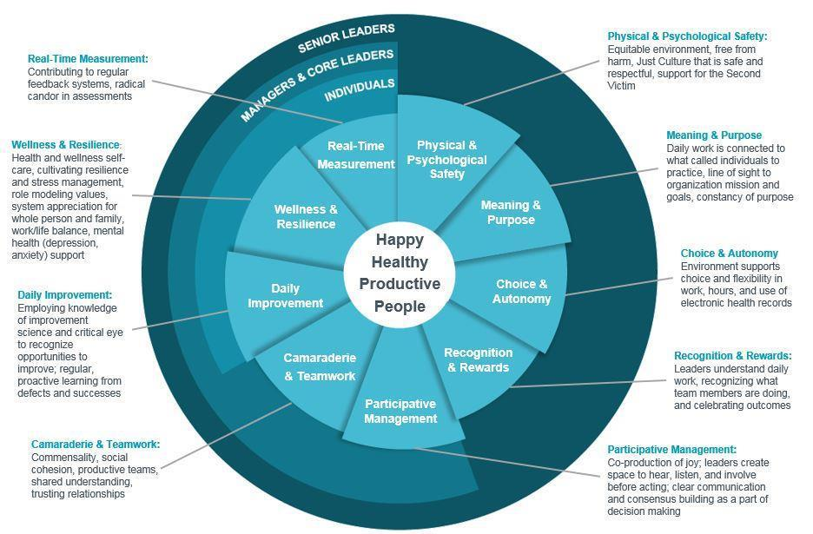
FAIRNESS AND EQUITY
Notes:
The IHI believes strongly in people being more productive if they are happy and healthy and this is something that we are keen to take on board in child health. We would like everyone in child health to be a healthy, happy, productive person and we as team joy would like to do what we can to improve the chances of this.
IHI recognises that there are some key domains that people need to achieve firstly and fore mostly, before they can be happy, healthy and productive at work (highlighted in yellow), all of which are underpinned by a need for a fairness and equity at work.

Slide 5
Spreading Joy in Child Health with Team Joy!
Our jobs can be tough at times, but also hugely rewarding and satisfying. We are a fantastic team here in child health, who deserve to be enjoying their days at work!
As a result, we want your feedback on the following:
Please look out for glittery boxes in staff rooms in which you can provide written feedback, email Team Joy with your suggestions - TeamJoy@uhs.nhs.uk
Have a joyful day!
Team Joy
Carol Paterson, Mrs Francesca Stedman, Dr Kate Pryde, Dr Jennifer Livings
What makes a great day at work?
What gets in the way of a great day at work?
What is a small and achievable change that would make things better at work?
Notes:
As Team Joy, we are hoping to begin to address these areas through three main questions. We are gathering this feedback through today’s workshops, via email from “Team Joy”, informal conversations on wards, and.....

Slide 6
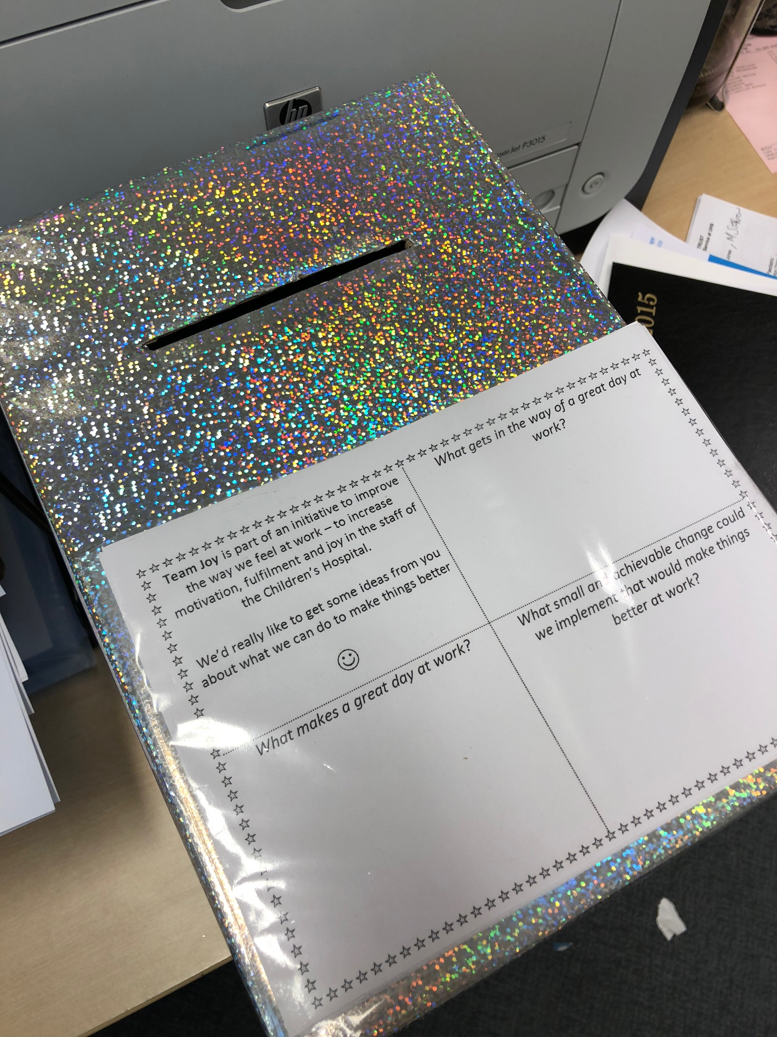
Notes:
We have glitter boxes in ward staff rooms for your ideas and suggestions

Slide 7
“Staff looking out for each other and talking politely to each other, caring for each other.”
“Having a nicer staff room.”
WHAT MATTERS TO YOU...?
“Being busy, but still pulling together as a team”
“Learning something new”
Notes:
What makes a good day at work?
I know I’ve made a difference when...
When we are at our best, it looks and feels like...
By asking these questions, it helps us to figure out what it is that makes some days more joyful than others!

Slide 8
“No support from colleagues.”
WHAT GETS IN THE WAY OF A GOOD DAY AT WORK...?
“Negative attitudes, rudeness.”
Notes:
Secondly,
What frustrates you at work?
What obstacles can get in the way of “what matters to you”?
This helps us to identify the day to day hassles that can impeded “good days” at work.

Slide 9
WHAT ARE SOME SMALL AND ACHIEVABLE CHANGES THAT WOULD HELP YOU FEEL MORE JOY AT WORK...?
“Themed monthly dress up days. These are something different for the teams and may put a smile on children’s faces if they come in to find Harry Potter or Spiderman on the ward!”
“Make the break room a happier and more comfortable place.”
Notes:
By focusing on small and achievable changes that can be implemented quickly, we can start to improve joy in the work!
Team Joy spent time on Bank Holiday Monday cleaning and sorting the junior doctor’s office to “spruce it up” and bring some joy in advance of the shared lunch that took place there that week!

Slide 10
Notes:
We are also monitoring “joy levels” via taking weekly opportunity sample snapshots across wards.
Hopefully many of you will have these one of these by now – a smiley face enjoyment survey. We collected some baseline data and are now collecting weekly data

Slide 11
Notes:
Baseline smiley face data – we are a relatively joyous bunch anyway!
Pie- chart = percentage of people over the course of the week who rated their days in each category
Run chart = mean joy levels each day (categories scored as 1 = strongly disagree, 5 = strongly agree).

Slide 12
G level weekly data
PICU weekly data
Notes:
Week one: 1st May
Week 9: 29th June
(some weeks missed out due to leave)
Where strongly agree is given a score of 5
The peak in week 5 for G level – very few respondants that week
Range 2 – 61, mean 22 people questioned each on PICU or G floor per week

Slide 13
Notes:
We will be creating a ‘joy board’ in the child health corridor and in PICU so that we can demonstrate what you have asked us to do and what we have done

Slide 14
Next Steps...
Notes:
Regular dress down days
Implementing “joy” as an action in PICU handovers via giving colleagues positive feedback
Looking at staff support levels across the hospital

Slide 15
Spread a little joy...!
Notes:
We want your ideas as we want to make things more joyous for YOU! Please help us!

Slide 16
teamjoy@uhs.nhs.uk
Notes:
And we can be contacted by email at the following address

Slide 17
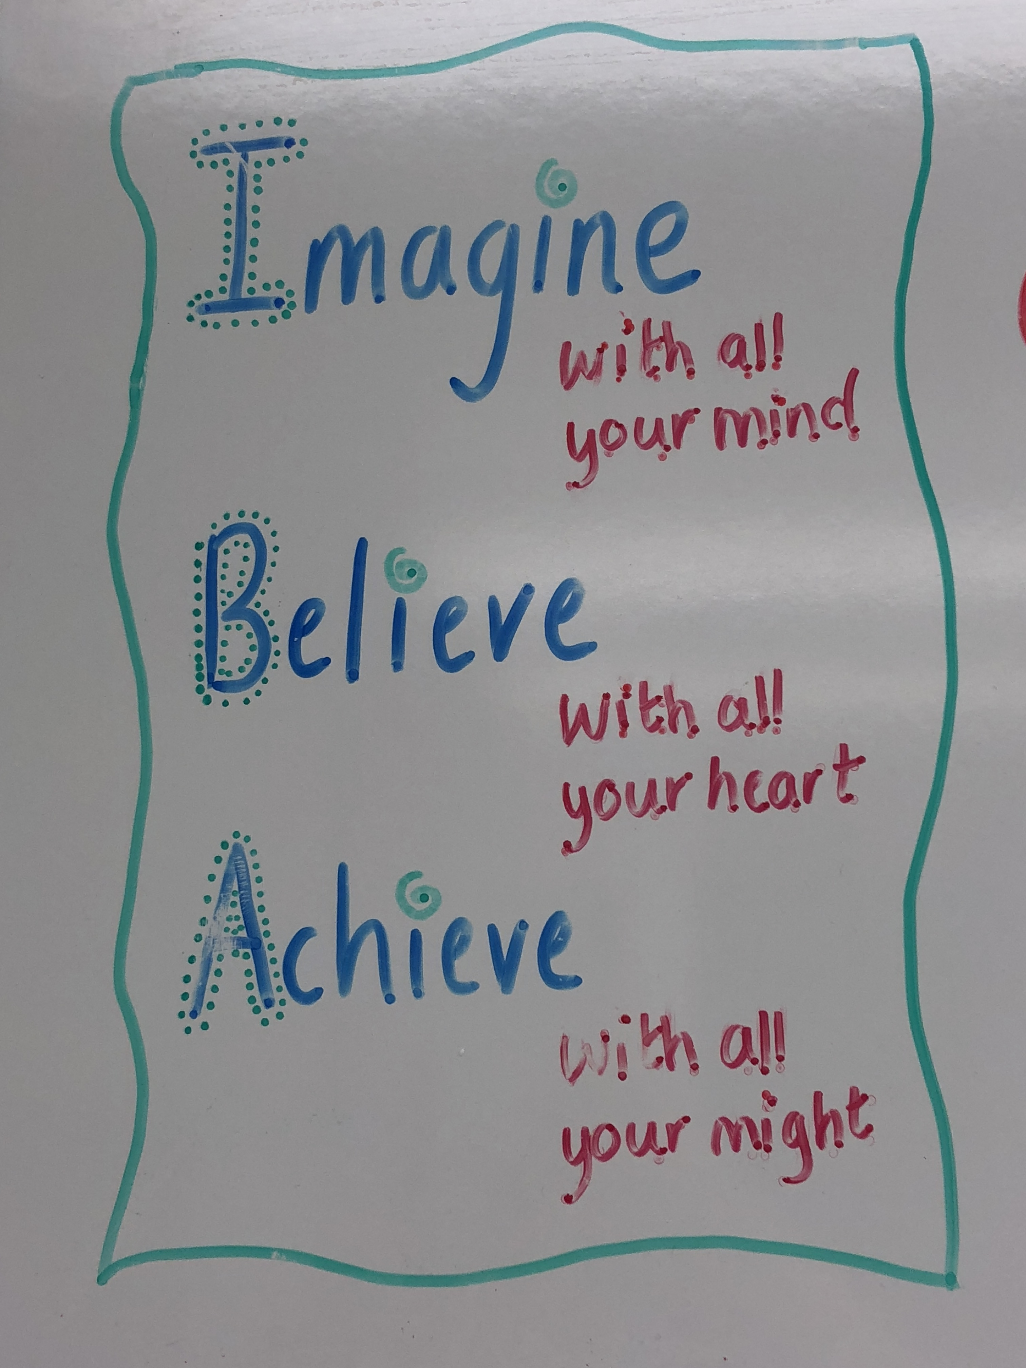
Notes:
Here are a couple of joyous snippets I’ve seen over the weekend

