Slide 1
CPR and music: teaching children to save lives.
Jennie Rowley, Clare Morden, Ben Houlford
& Victoria Ivison

Slide 2
What is HeartBeatz UK?
HeartBeatz UK is a charity set up to teach basic life support to primary aged children, teachers and parents.
HeartBeatz UK is unique as we use music as an adjunct to aid learning and knowledge retention.
Notes:
In England, the ambulance service attends approximately 30,000 cases of cardiac arrest every year¹. The survival to discharge rate for these patients is less than 8%¹. Survival rates vary across the world from 0.6% to 25%, the highest of which occur in countries where bystander cardiopulmonary resuscitation (CPR) is commonly performed, and where CPR is taught to children^{2,3}.
At present CPR does not feature on the UK National Curriculum. A pilot programme teaching CPR to children aged 7-11 (key stage 2) has been performed. This programme is unique as it uses music as an adjunct to aid learning and knowledge retention. It is hoped that teaching these skills to children at a young age will increase the rates of bystander CPR in the future⁴.

Slide 3
Why is teaching BLS important?
Survival rate from out of hospital cardiac arrest (OOHCA) is 8%
For every minute that CPR is delayed the chance of survival decreases by 10%
Survival rates in countries where bystander CPR is commonly performed are far higher.
Behind the times in the UK with health promotion and education
We hope that teaching these skills to children at a young age will increase the rates of bystander CPR in the future.
Notes:
In England, the ambulance service attends approximately 30,000 cases of cardiac arrest every year¹. The survival to discharge rate for these patients is less than 8%¹. Survival rates vary across the world from 0.6% to 25%, the highest of which occur in countries where bystander cardiopulmonary resuscitation (CPR) is commonly performed, and where CPR is taught to children^{2,3}.
At present CPR does not feature on the UK National Curriculum. A pilot programme teaching CPR to children aged 7-11 (key stage 2) has been performed. This programme is unique as it uses music as an adjunct to aid learning and knowledge retention. It is hoped that teaching these skills to children at a young age will increase the rates of bystander CPR in the future⁴.

Slide 4
Getting started
Survey of schools – exploring barriers
Music written and arranged by Portsmouth Music Hub
Logos drawn by Jane Franklin
Equipment donated courtesy of Philips
Support with printing/recording and illustrations from Irwin Mitchell
Volunteers recruited to help teach in the schools
Pilot schools chosen by Portsmouth Music Hub
Parent and teacher sessions included
Notes:
5 pieces of music have been written, each at 100-120bpm. The song lyrics provide a stepwise account of how to perform basic CPR and therefore act as an aide memoire.

Slide 5
Teaching to date
A pilot has been completed, with teaching performed in 15 primary schools in Portsmouth.
Role out teaching began last week with 3 more schools in Portsmouth
Over 4500 children and hundreds of teachers have been taught to date.
Two parent sessions have also taken place.

Slide 6
How does it work?
Before we visit the Music Hub teaches the children the HeartBeatz songs .
The day begins with an introduction and demonstration assembly.
The children all receive a 30 minute practical session
Compression only basic life support and defibrillation taught in small groups
Cardiac compressions competition
Teacher education session (with similar parent sessions if requested)
Compression only CPR and defibrillation
Discussion of the difference between adult and child CPR
Choking
Inhaler technique
Use of adrenaline auto-injector devices.
Notes:
5 songs explaining CPR and defibrillator use were specifically written and taught in schools by the regional Music Hub. Subsequently, medics attended each school to teach the pupils and staff CPR skills. Teaching incorporated an assembly, a demonstration, small group teaching and assessment of skills.

Slide 7
Time for an example?
Notes:
5 songs explaining CPR and defibrillator use were specifically written and taught in schools by the regional Music Hub. Subsequently, medics attended each school to teach the pupils and staff CPR skills. Teaching incorporated an assembly, a demonstration, small group teaching and assessment of skills.

Slide 8
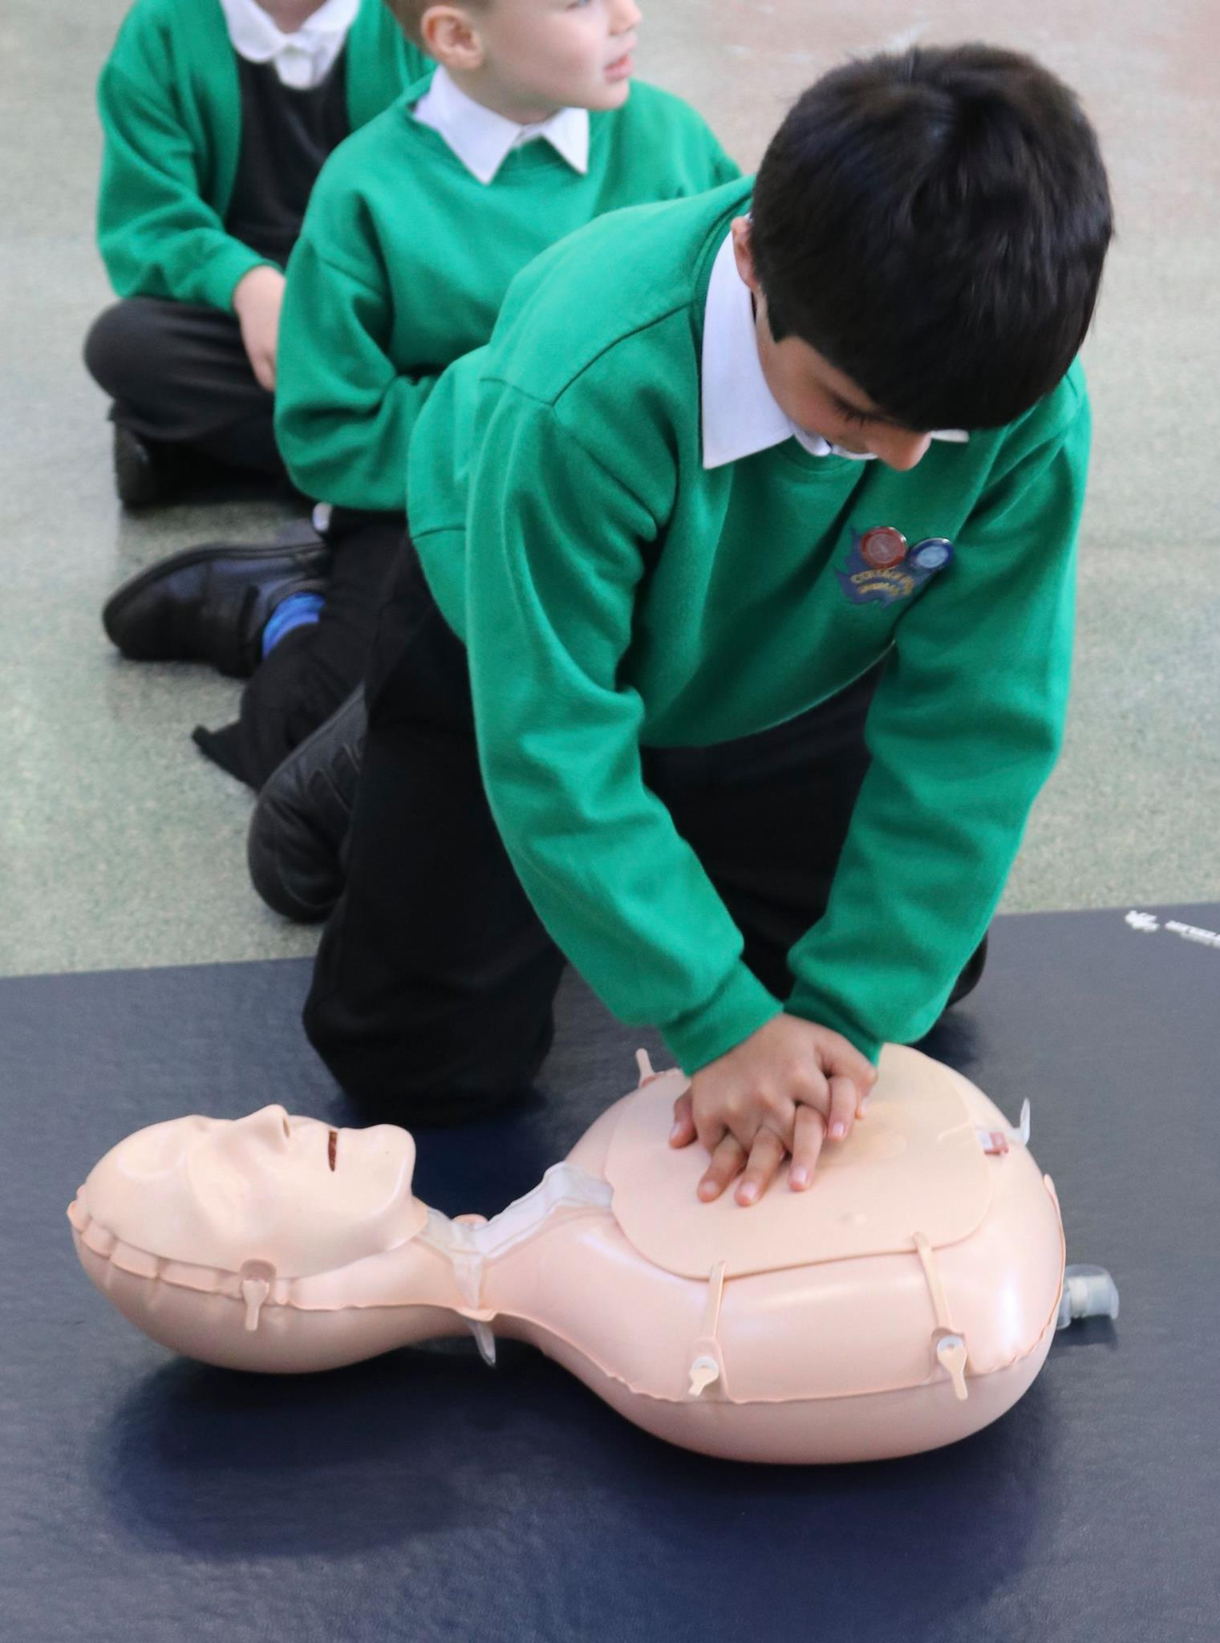
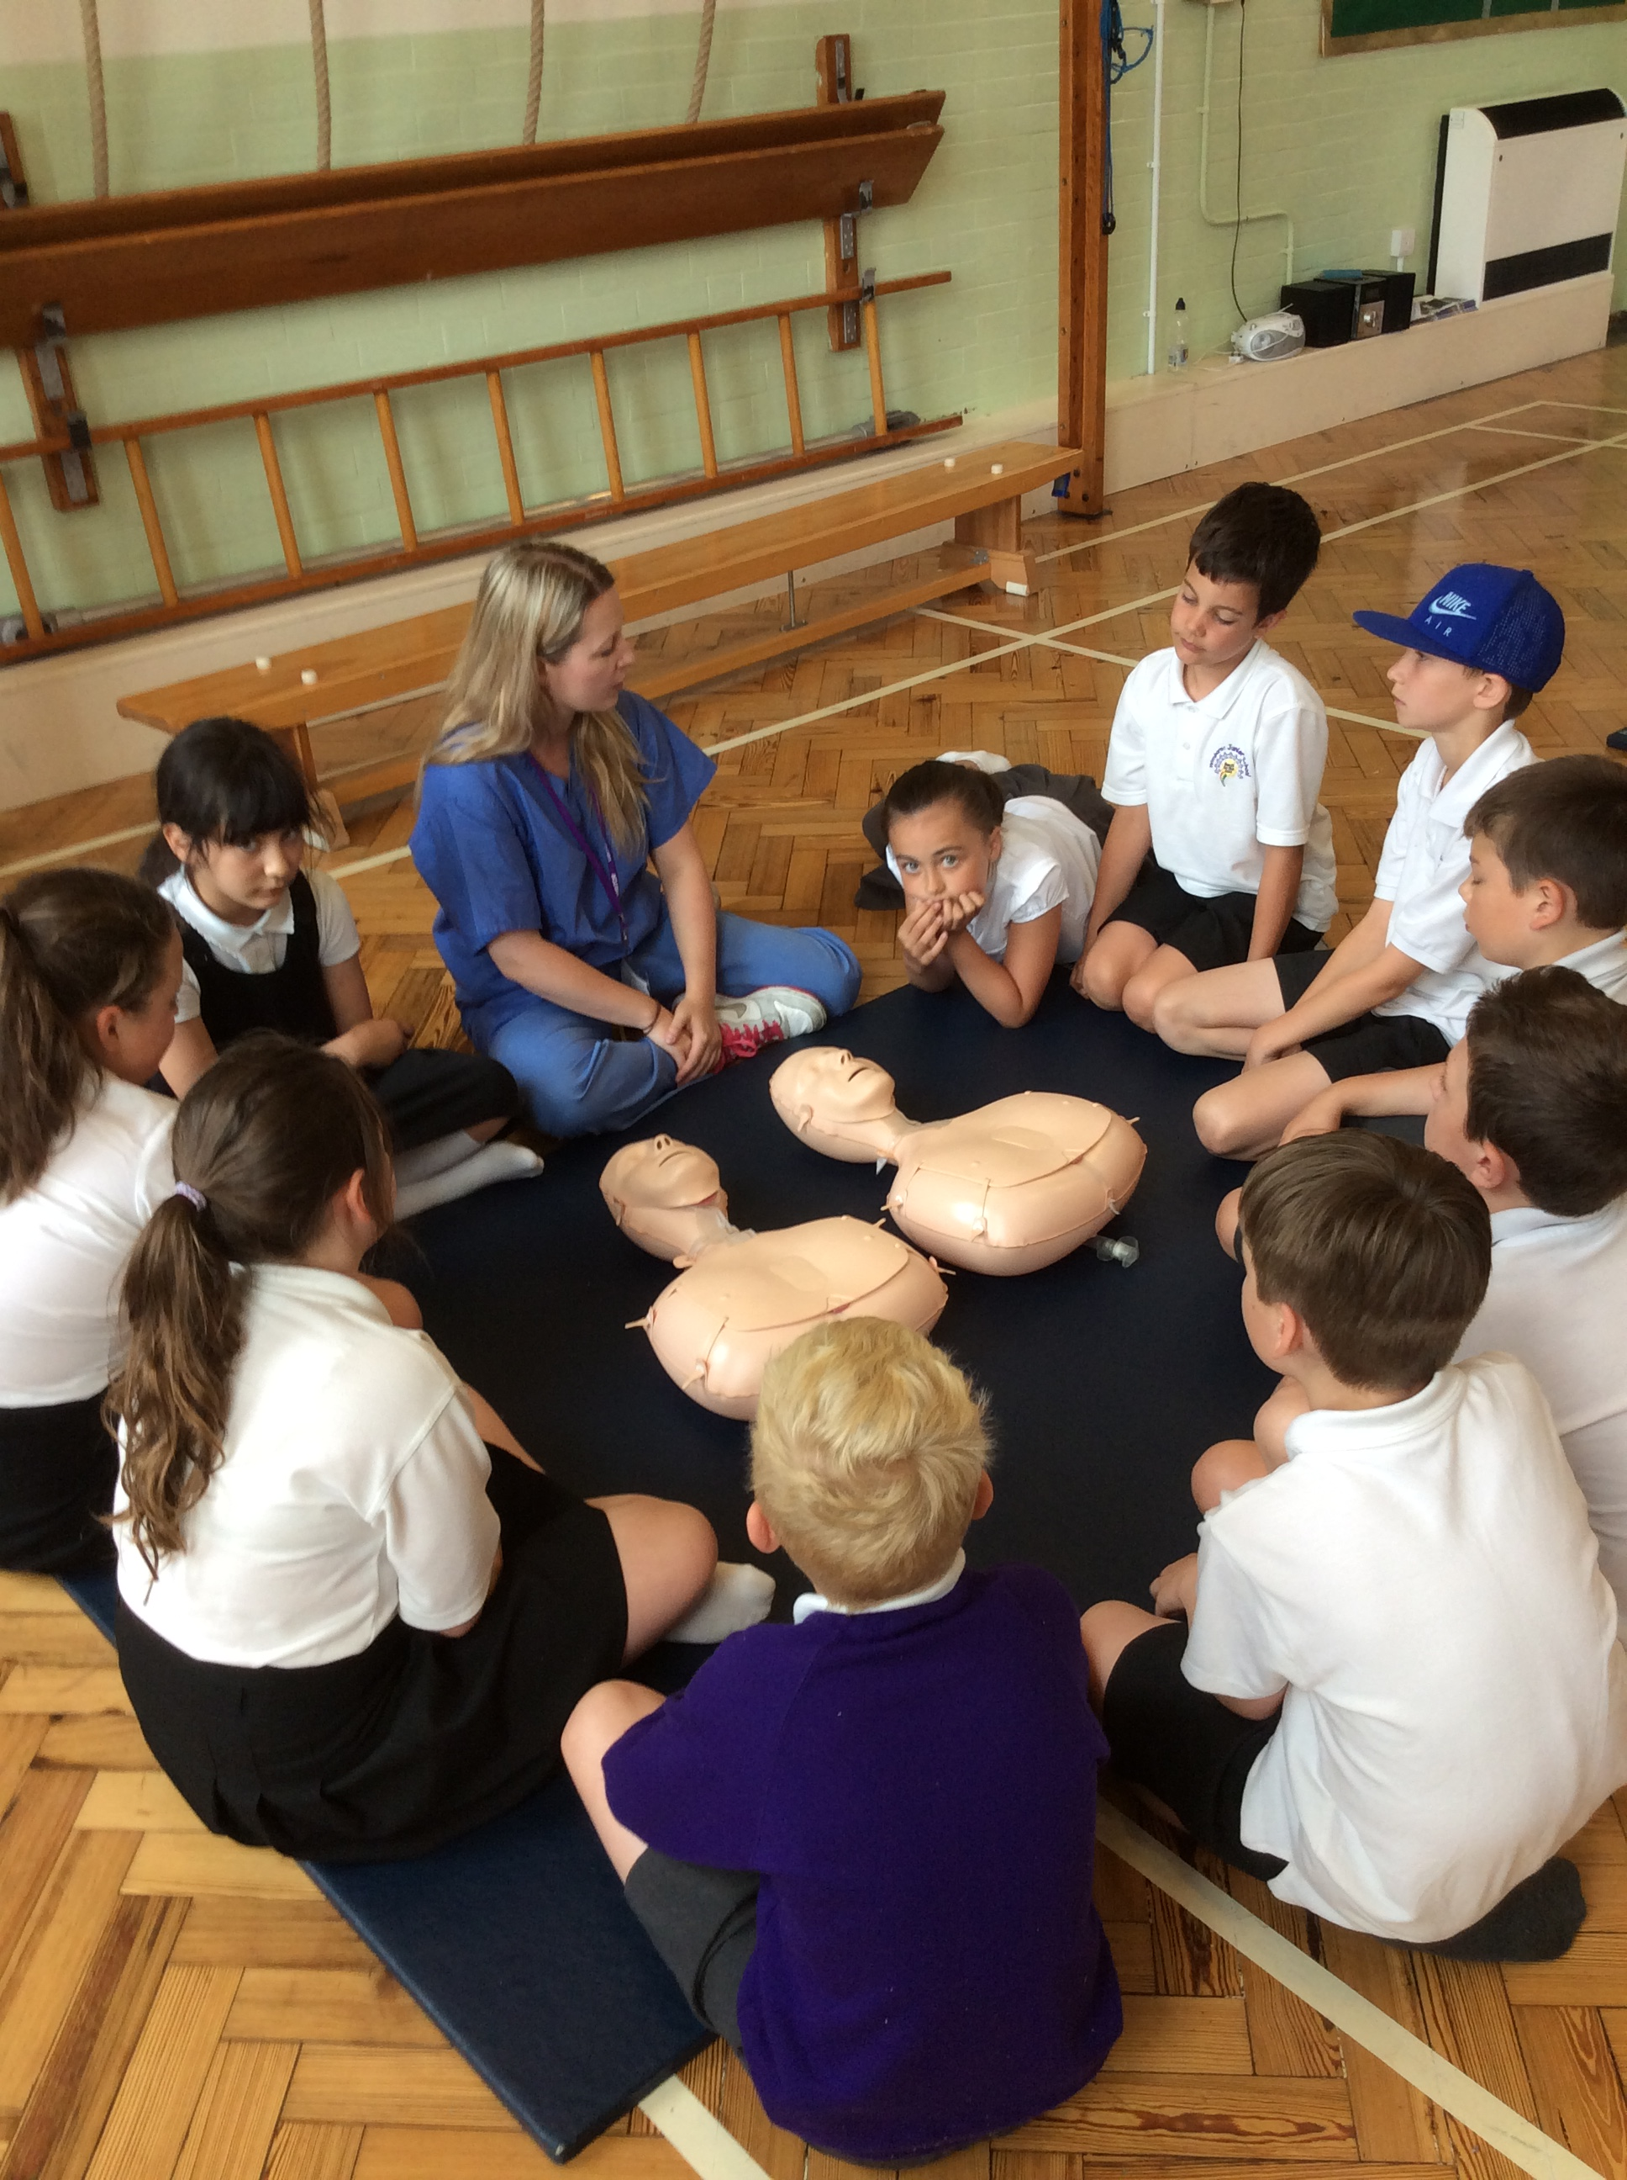
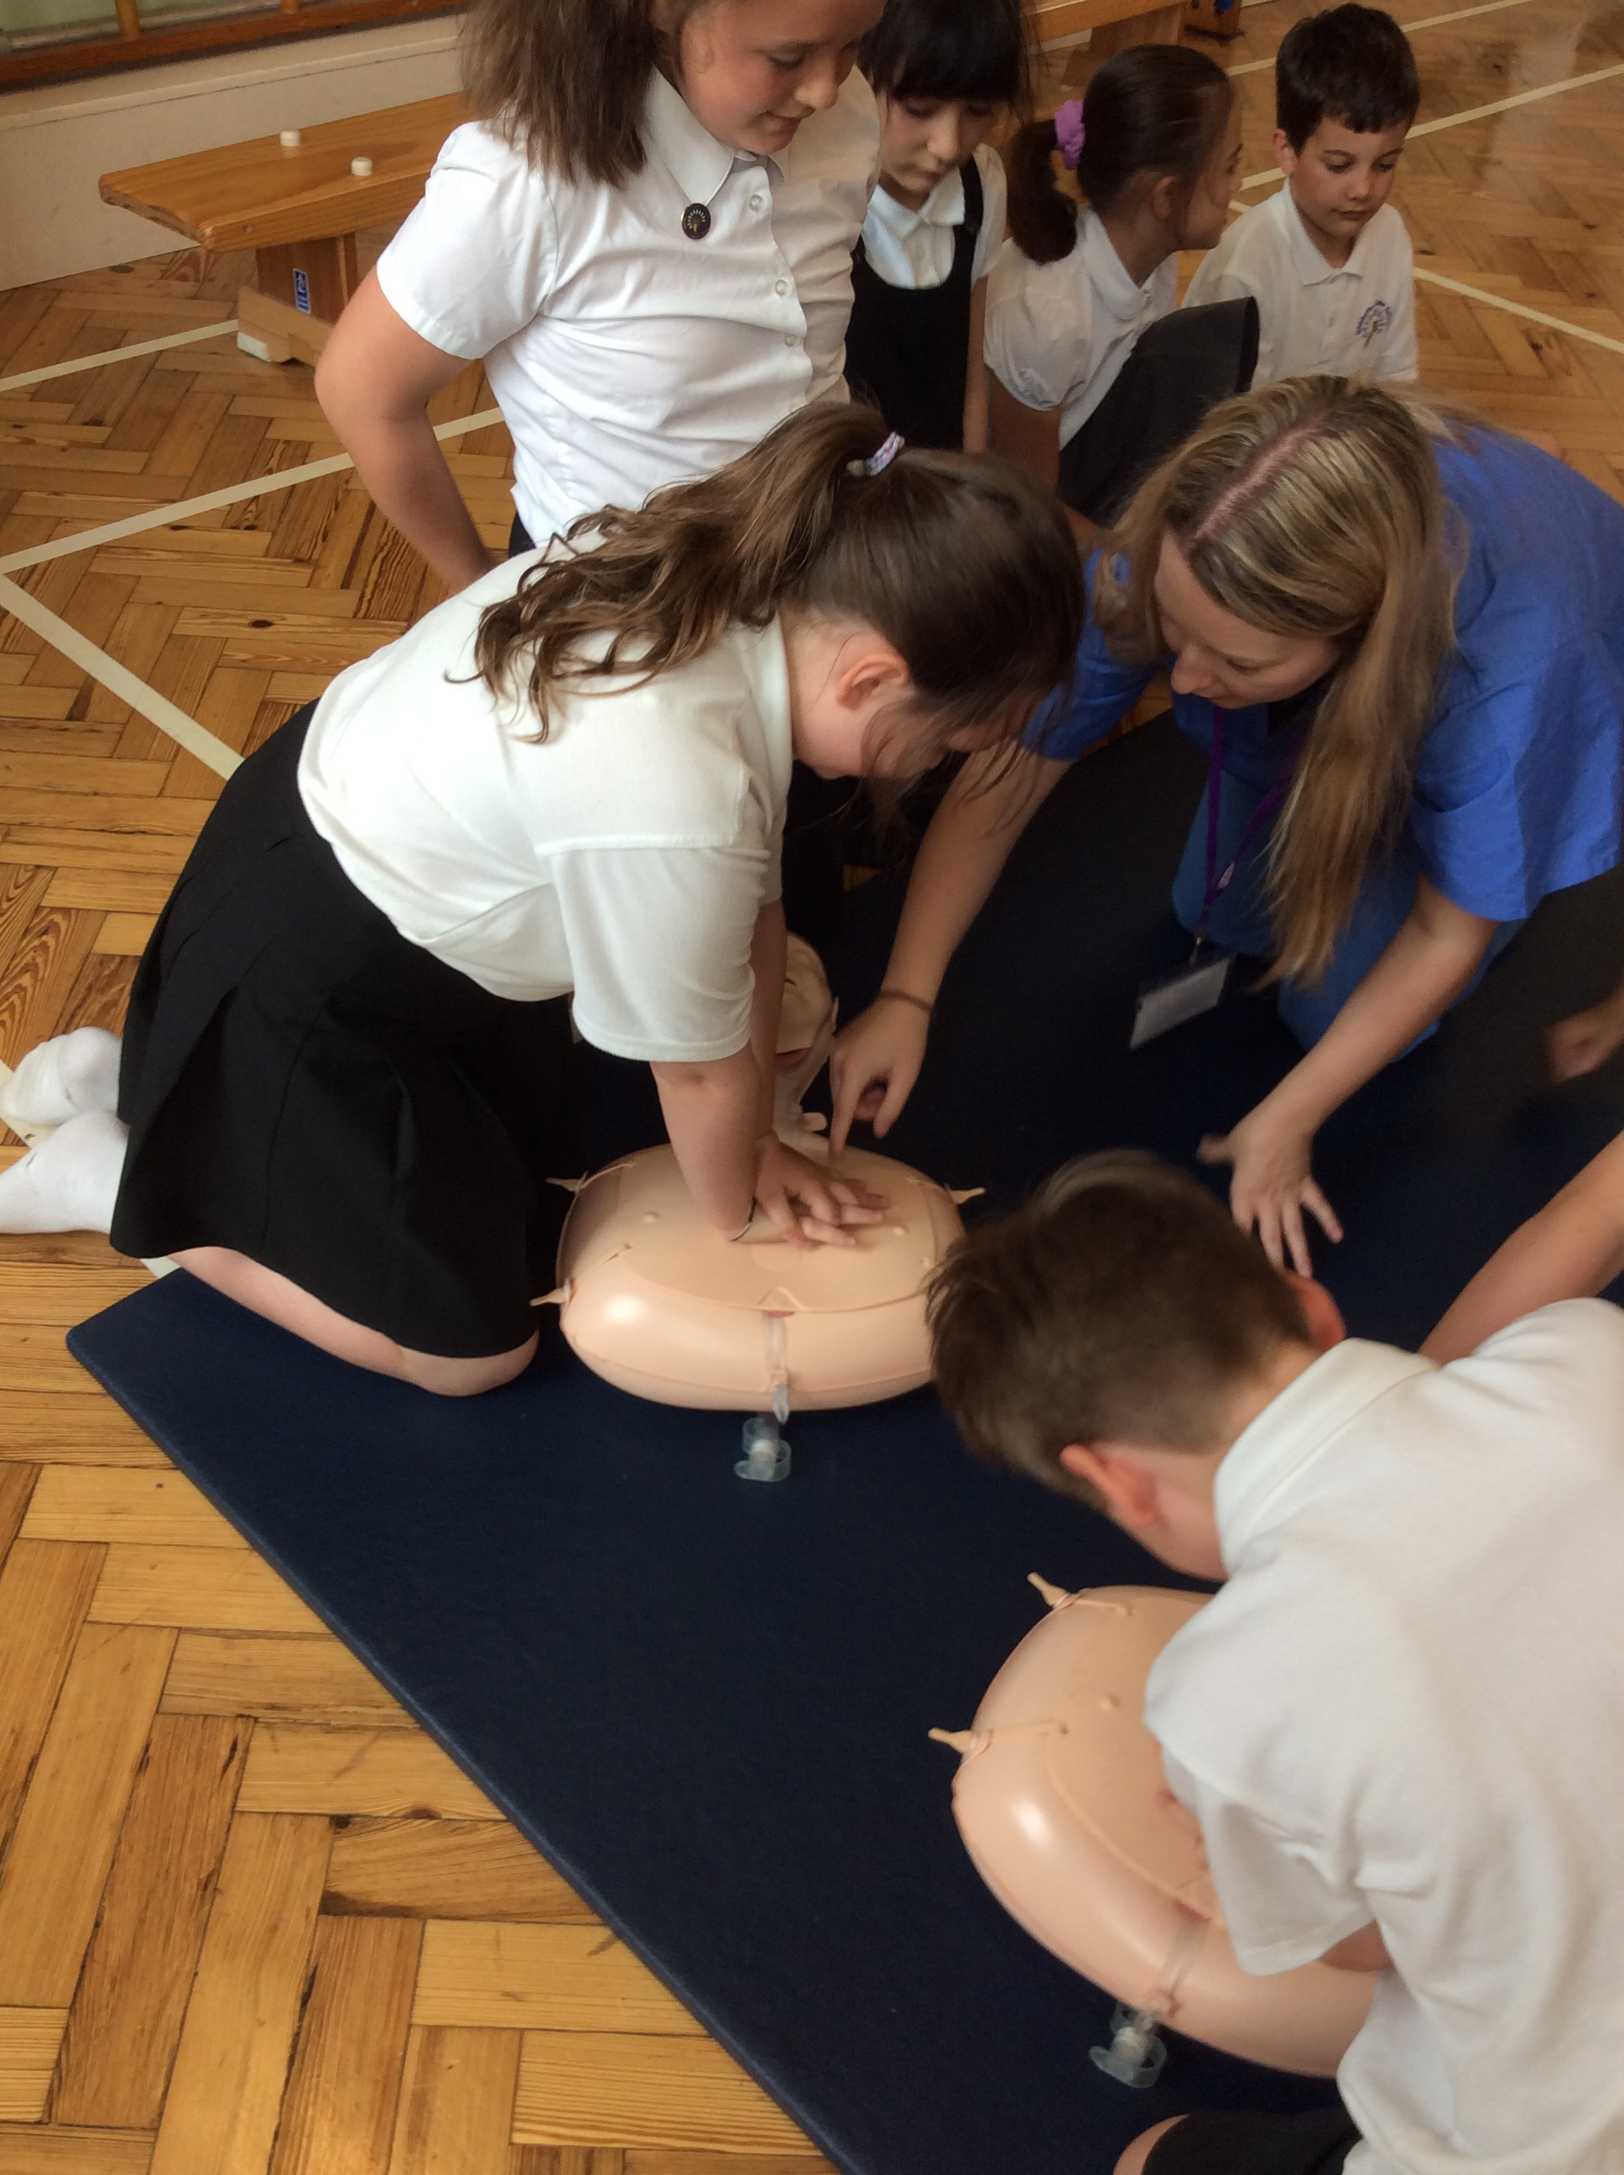
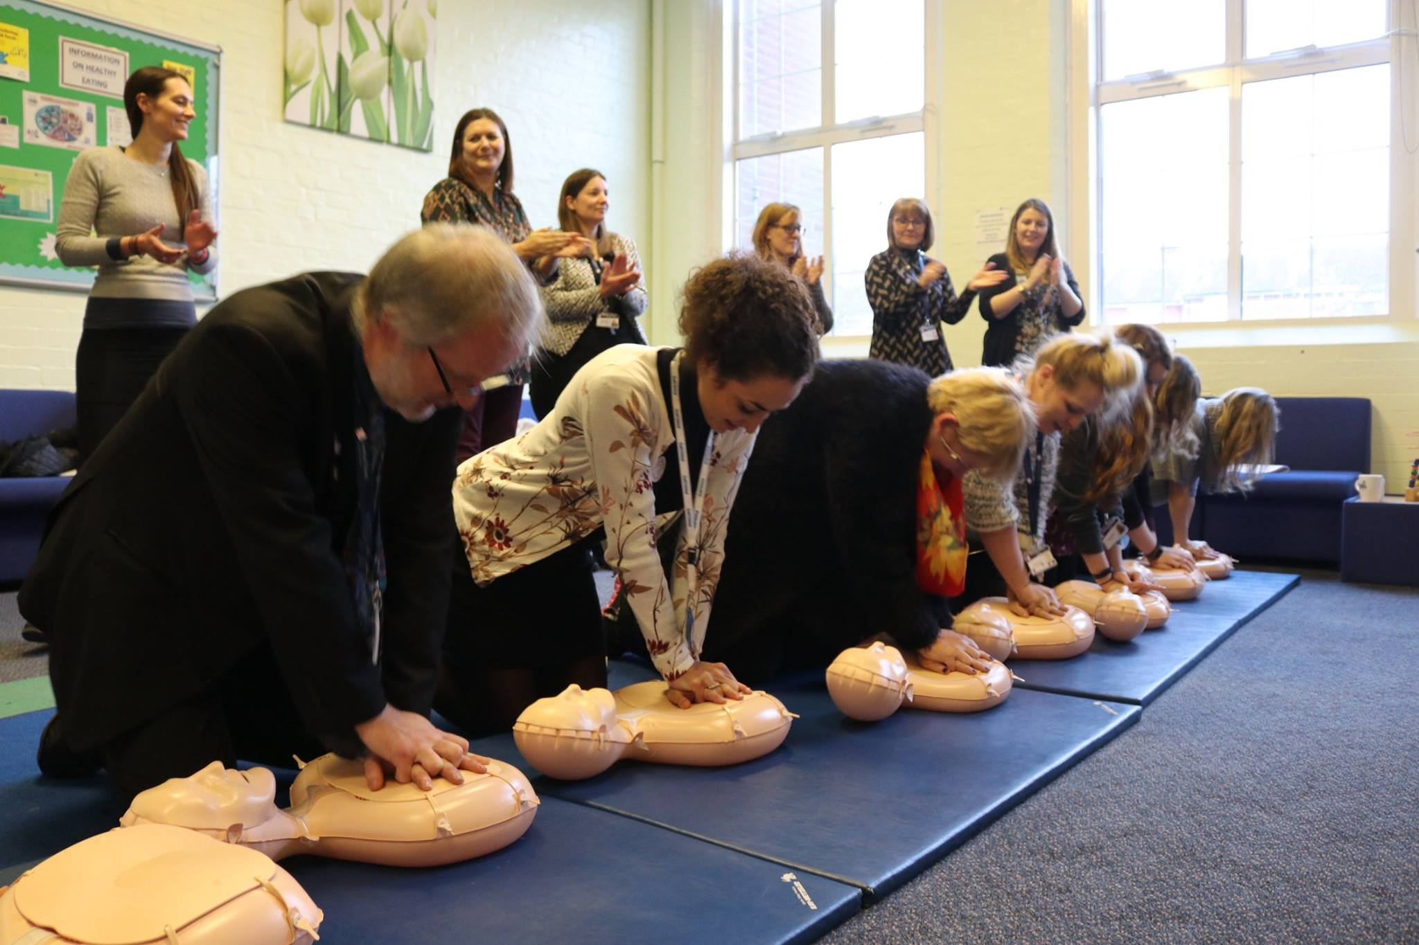
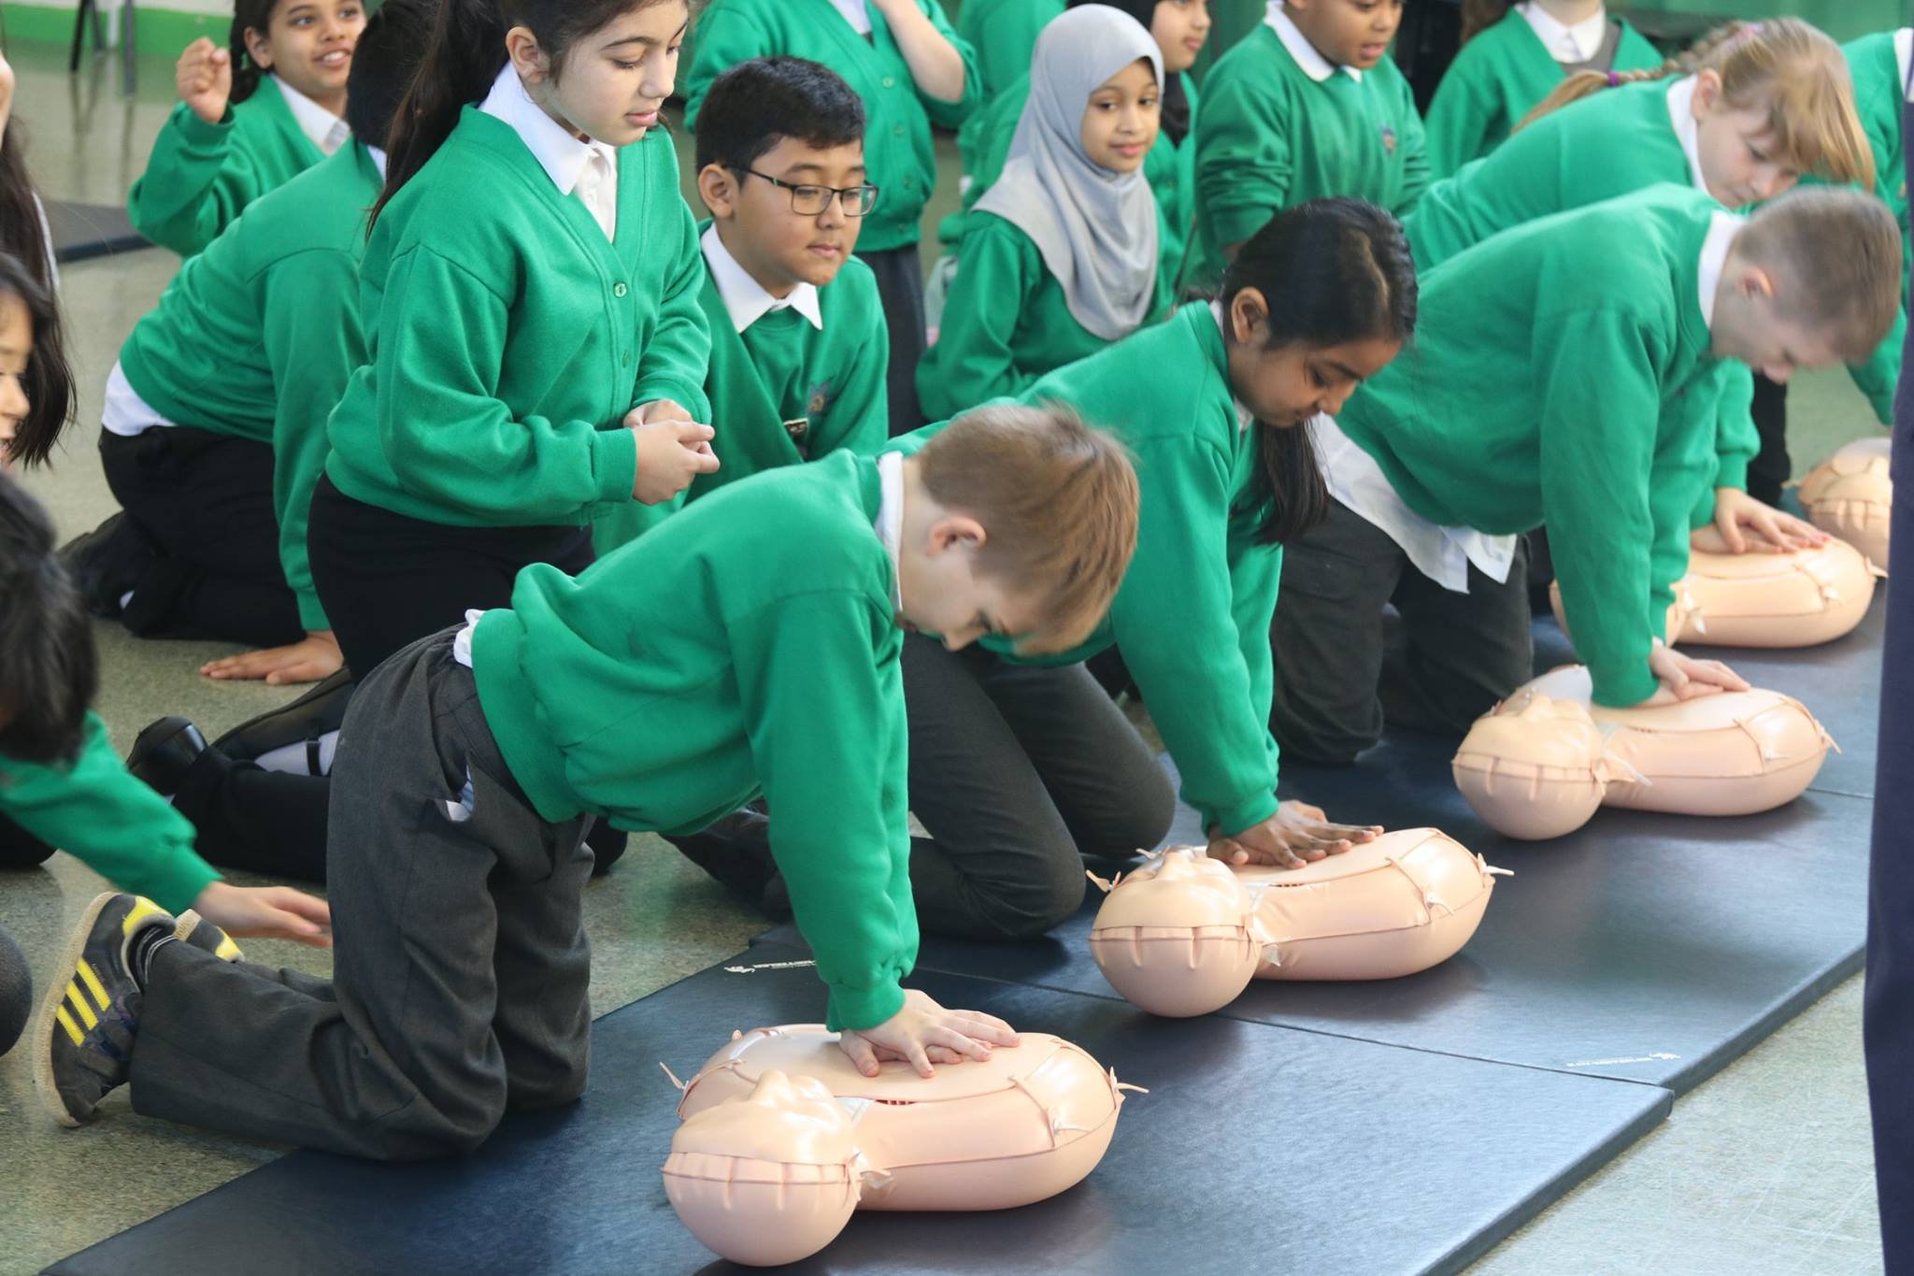
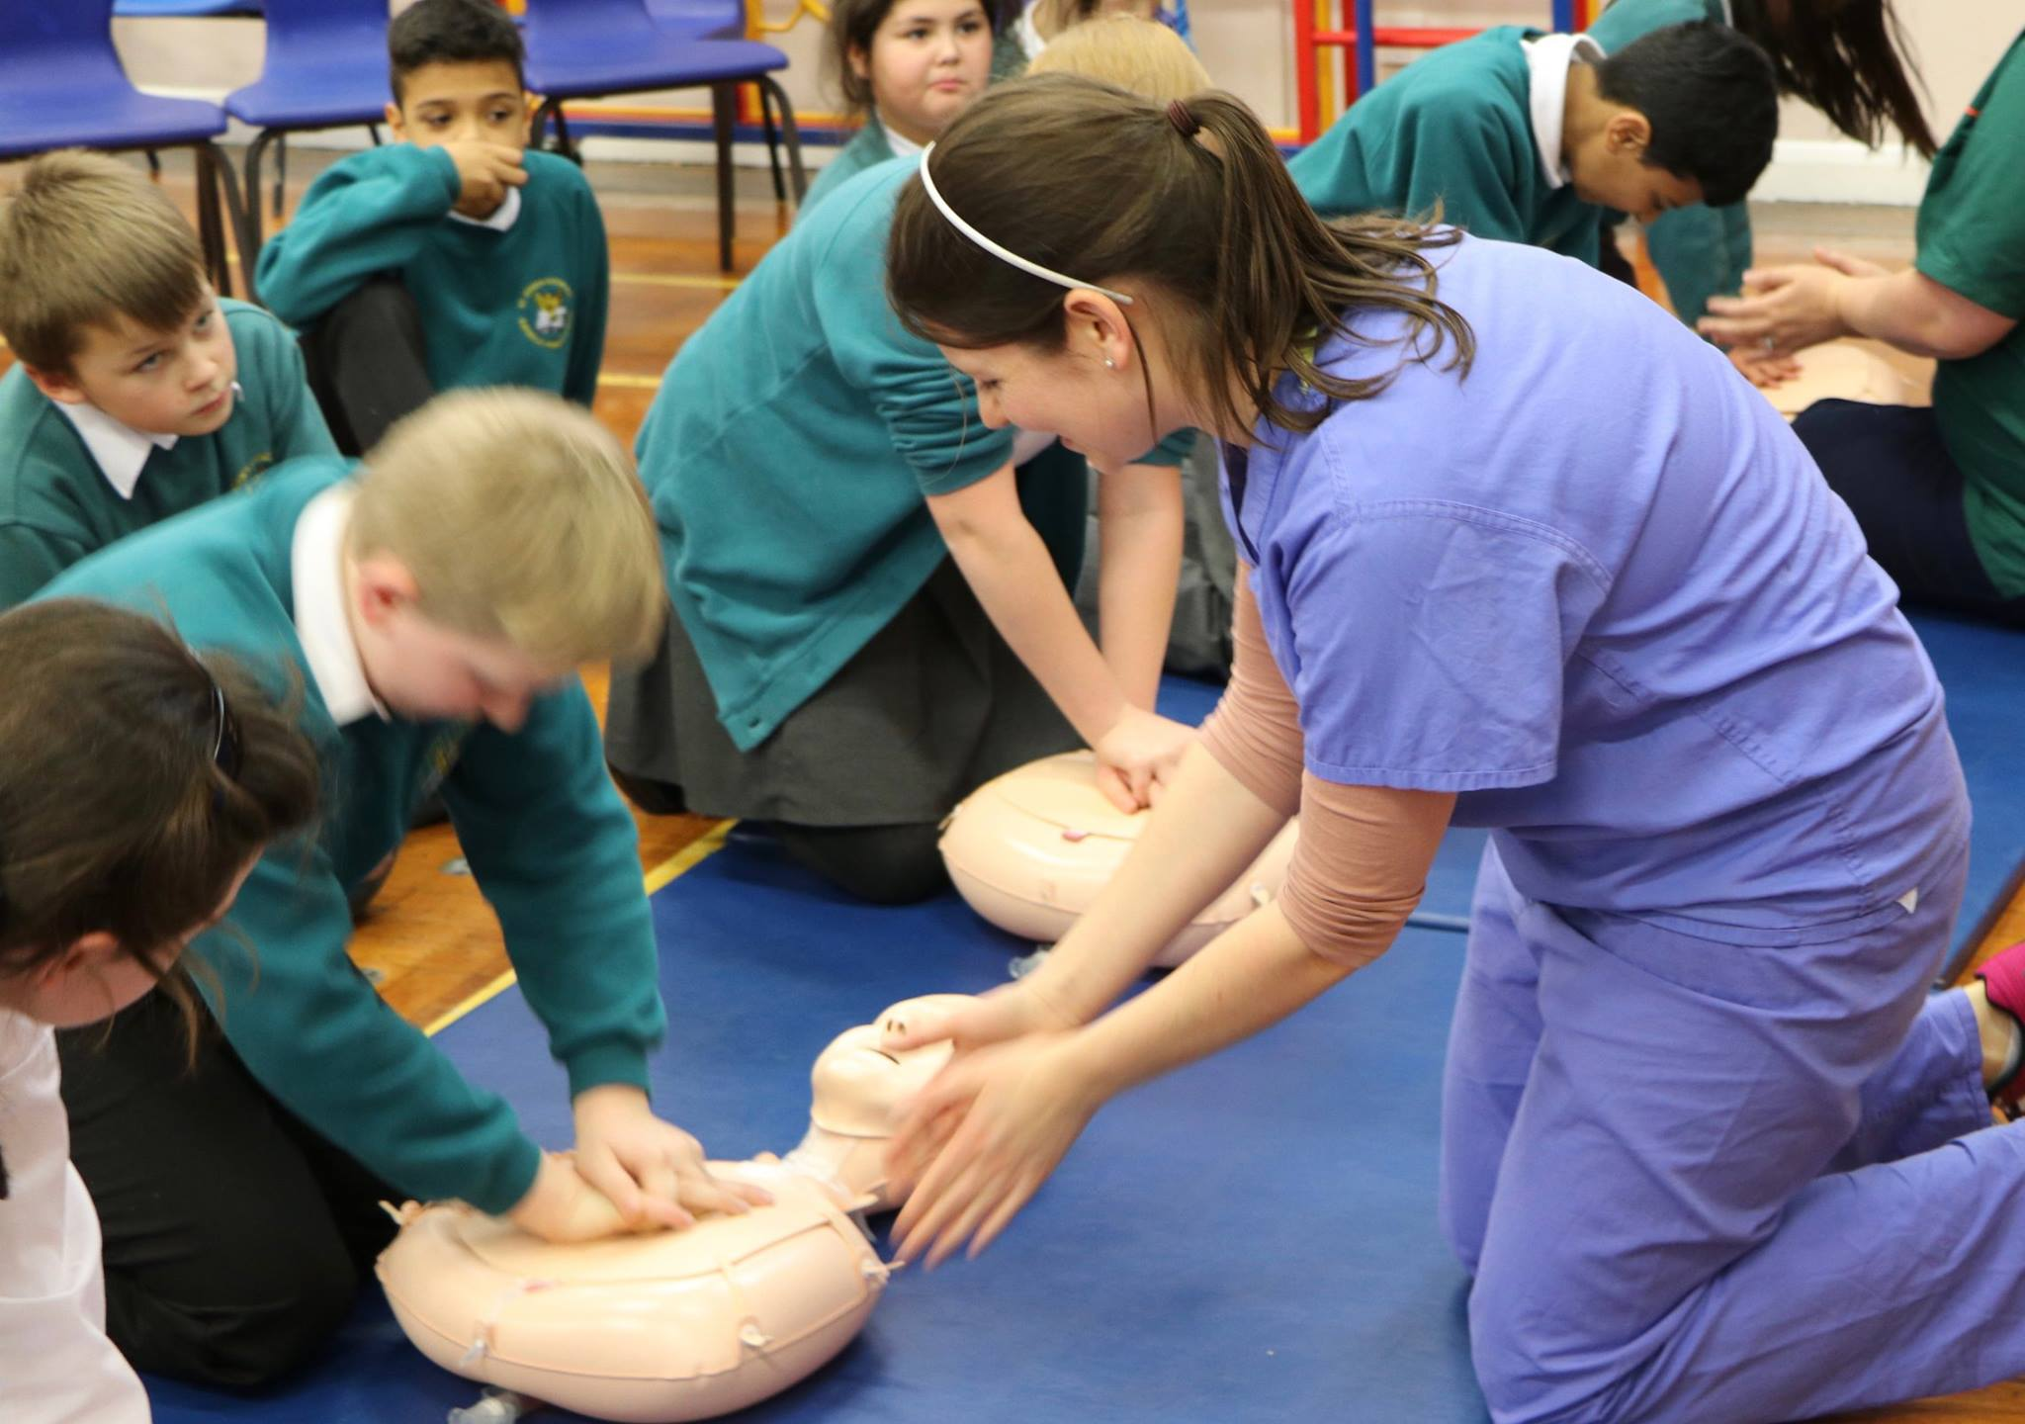
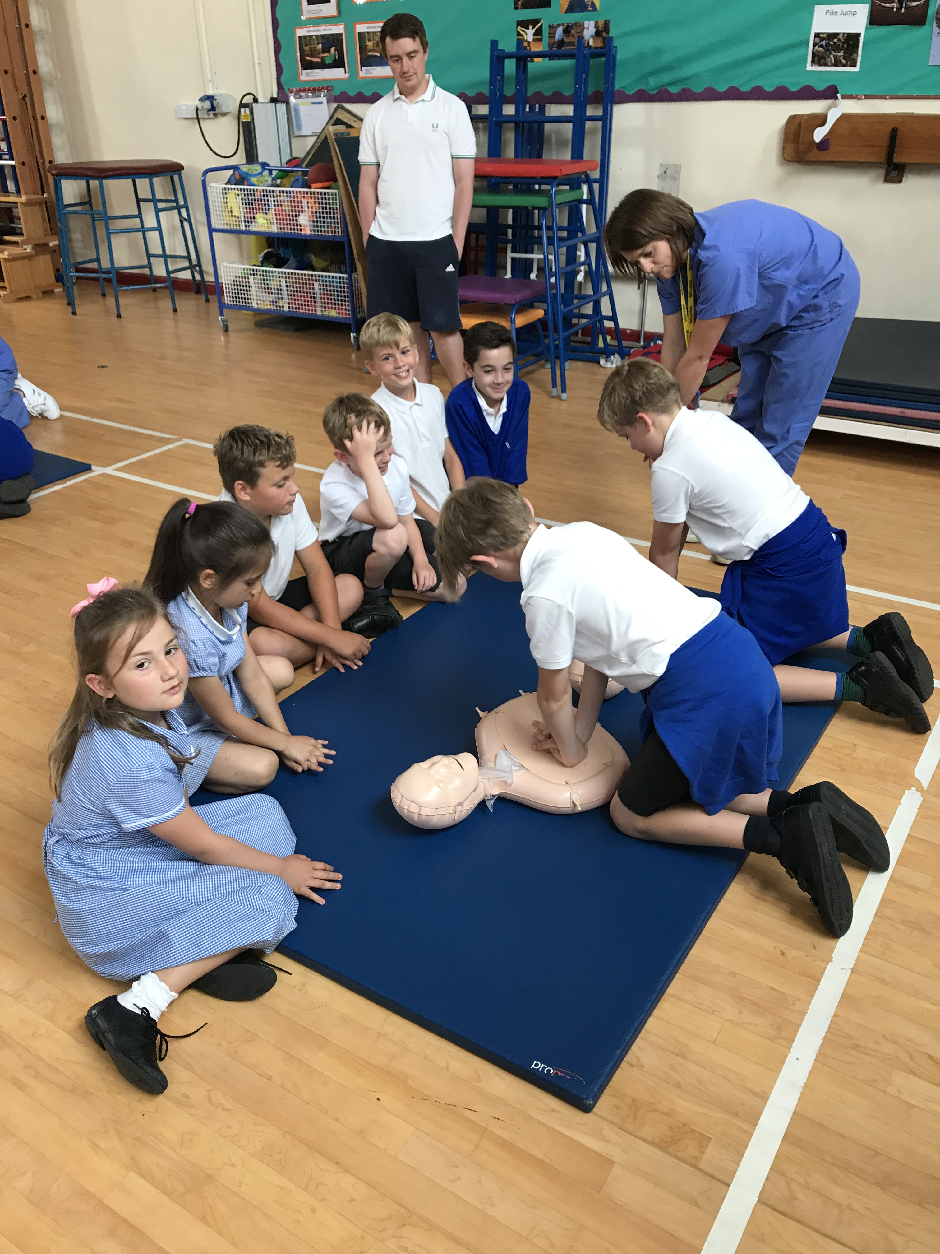
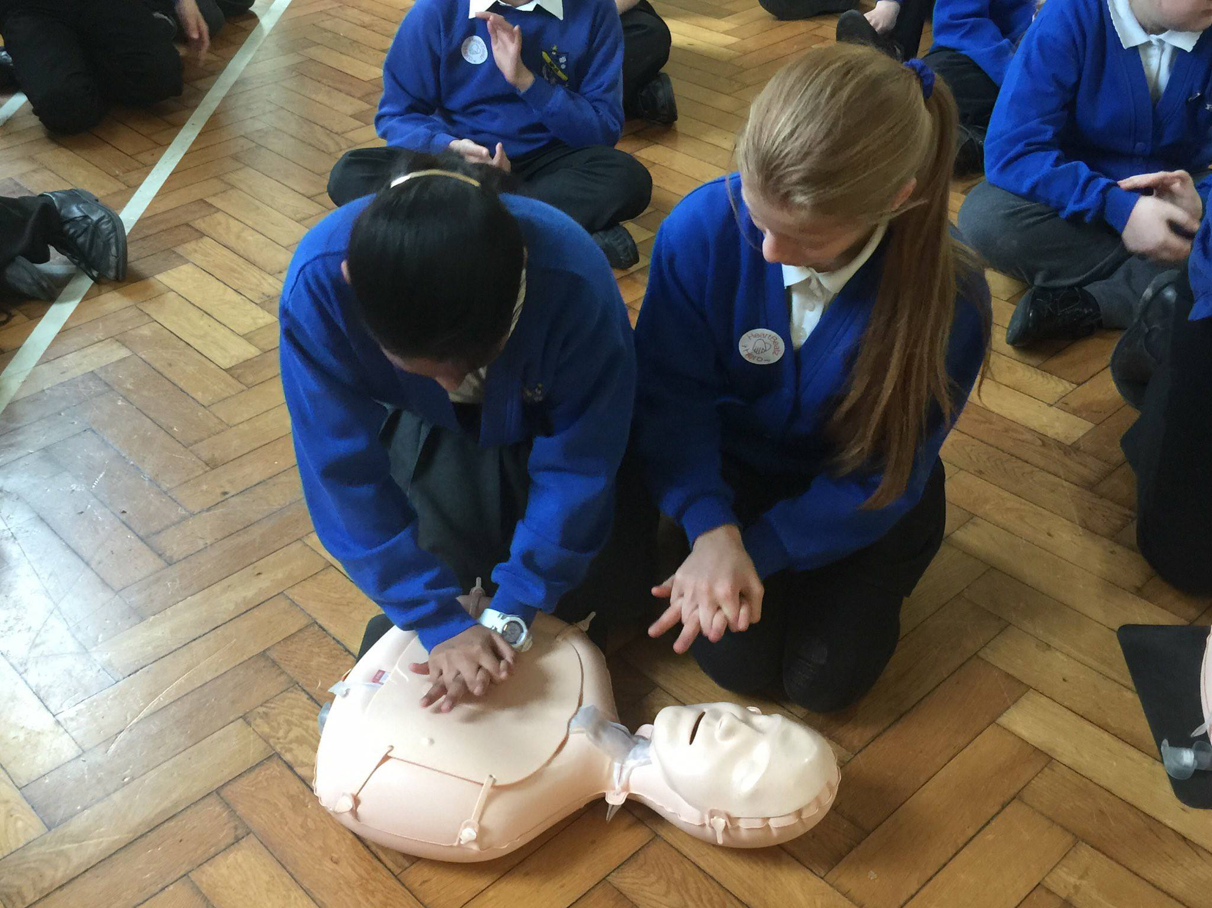
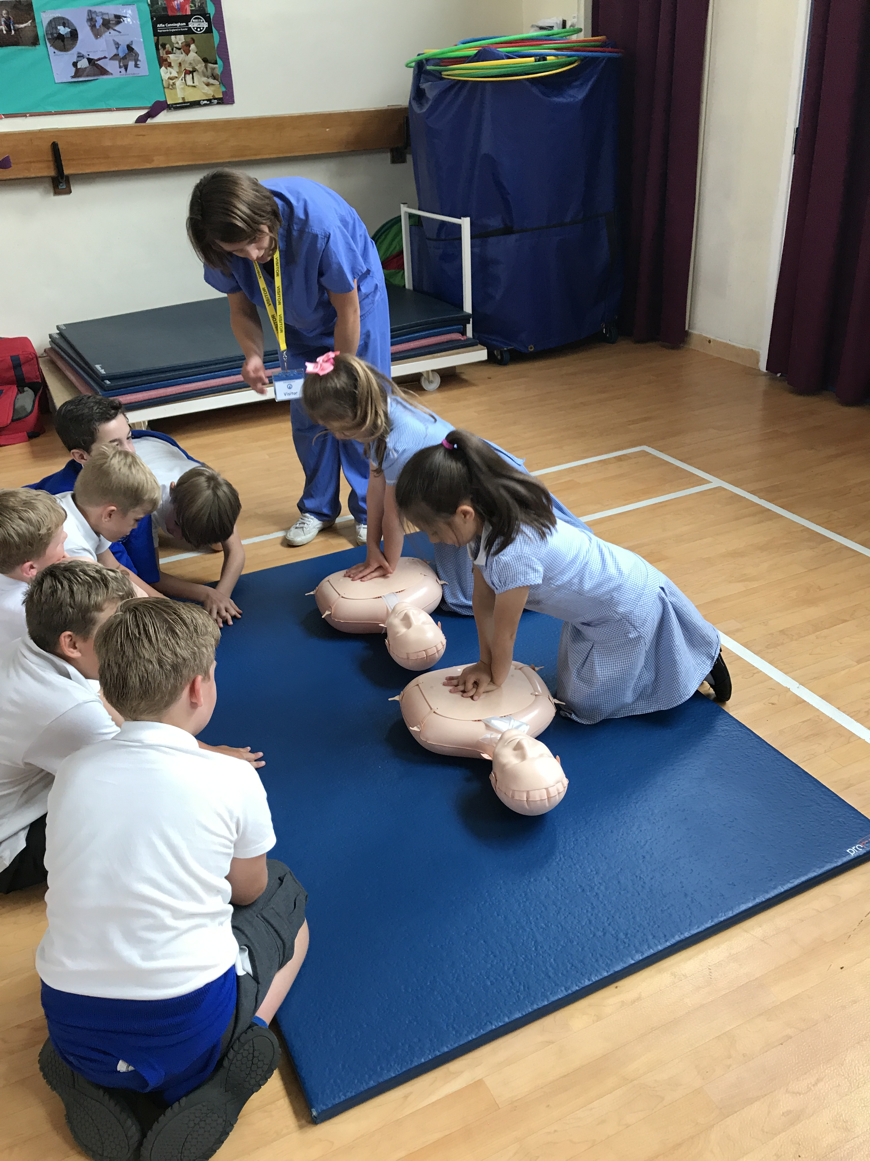
Keep that heartbeat
Lock your hands, place on the chest,
Keep both your arms straight, you know the rest.
Get in a rhythm, deep every time,
Just keep on going, you’re doing fine.
If you’re tired swap with a friend, it can’t stop,
Remember keep that heartbeat.
Keep it up ‘til help arrives, don’t give up,
Remember keep that heartbeat.
Keep that heartbeat.
Keep that heartbeat.
Someone’s in trouble, what will you do?
Check if they’re breathing, or talking too.
Time to get help now, call 999.
Roll both your sleeves up, because it’s time.
Remember all the things they said when the medics trained you,
Keep that heartbeat.
Now’s the time for CPR, it’s up to you,
Remember keep that heartbeat.
Lock your hands, place on the chest,
Keep both your arms straight, you know the rest.
Get in a rhythm, deep every time,
Just keep on going, you’re doing fine.
If you’re tired swap with a friend, it can’t stop,
Remember keep that heartbeat.
Keep it up ‘til help arrives, don’t give up,
Remember keep that heartbeat.
Notes:
5 songs explaining CPR and defibrillator use were specifically written and taught in schools by the regional Music Hub. Subsequently, medics attended each school to teach the pupils and staff CPR skills. Teaching incorporated an assembly, a demonstration, small group teaching and assessment of skills.

Slide 9
Feedback
“It was really exciting and I learnt some important lifesaving skills.”
Dexter, aged 8.
“I thought it was really, really good because we got to learn how to help someone in a bad situation. It was really fun!” Oakley, aged 10.
“It was really good doing CPR to the beat of the song.”
Harrison, aged 7.
“I’ve never seen the children so focused and engaged. They thoroughly enjoyed the songs and they learnt the importance of being able to save someone’s life.”
Miss Westley, Year 4.
“The songs are very catchy which helps the children remember what to do. I thought it was a great and fun opportunity for the children to learn a lifesaving skill.”
Mrs Roberts, Year 6.
“It was a tremendous joy to see all the children so engaged.”
Mr Andrews, Year 4.
Notes:
Key stage 2 children are very receptive to learning CPR and defibrillation skills, and the use of music enhances pupil engagement and learning. Feedback from pupils, teachers and parents has been very positive to date. Feedback has also been used to modify the sessions as the pilot progressed. This feedback was received from the initial 5 pilot schools

Slide 10
We even have a rap!

Slide 11
Next steps
Teaching this term in a further 6 schools in Portsmouth, 8 schools in Southampton, 8 schools on the Isle of Wight, and 7 schools in Plymouth.
Formal launch of HeartBeatz UK on 16th October, 10:30-12:00 in the main foyer of Queen Alexandra Hospital, Portsmouth

Slide 12
How can I get involved?
Volunteering to teach one of the best and most receptive audiences you will ever have!
Spread the word about HeartBeatz UK
Joining the charities committee or becoming a trustee
Fund-raising

Slide 13
With thanks to our sponsors & associates
Irwin Mitchell
Portsmouth Music Hub
Philips
Laerdal

