Slide 1
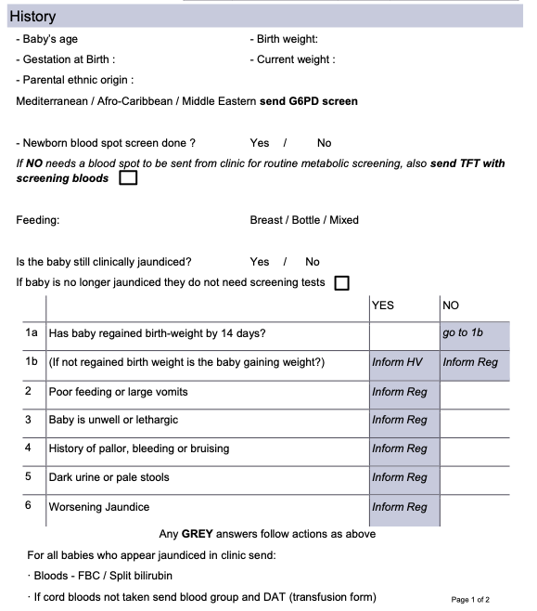
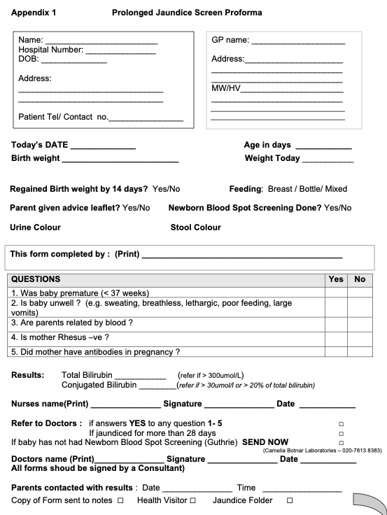
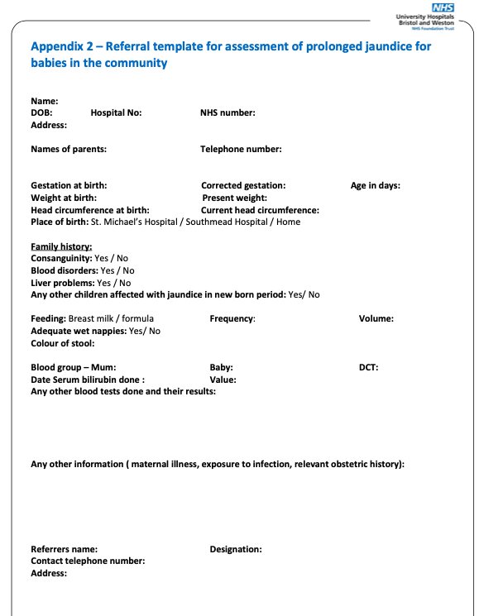
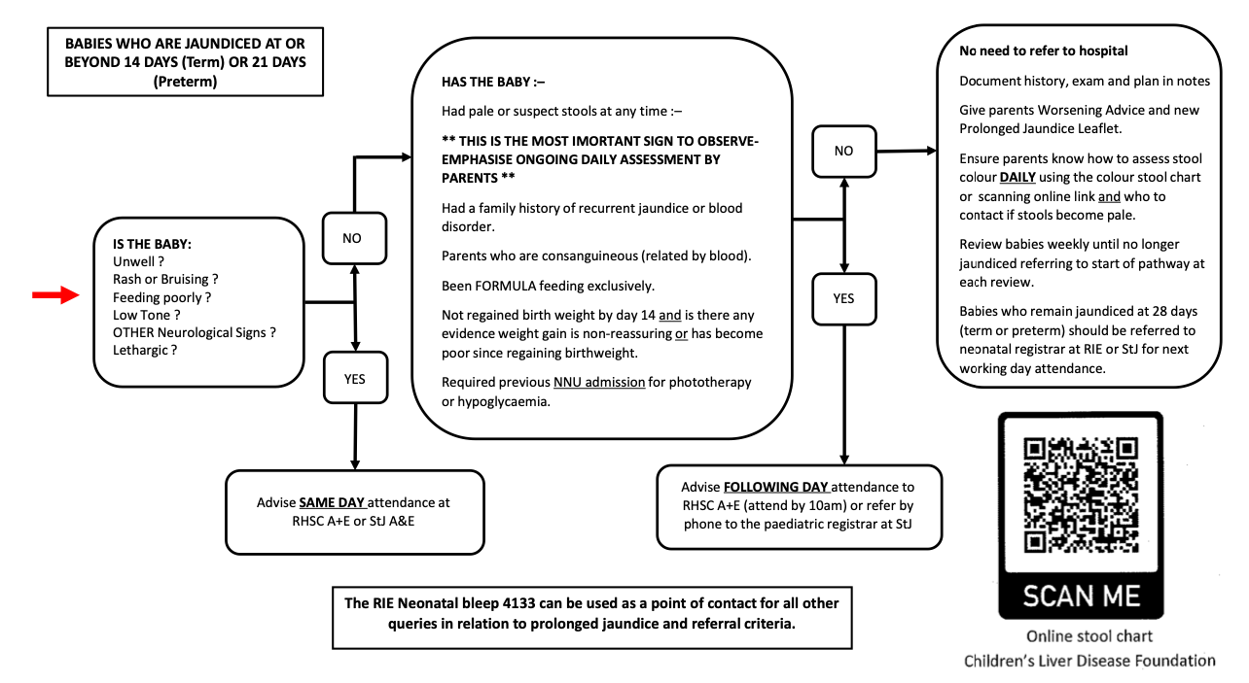
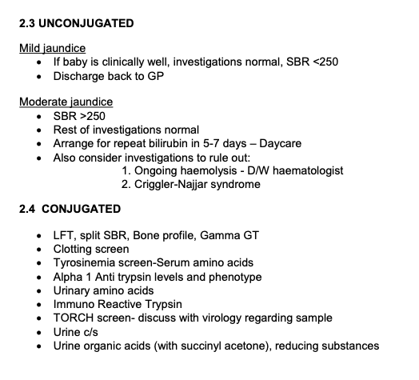
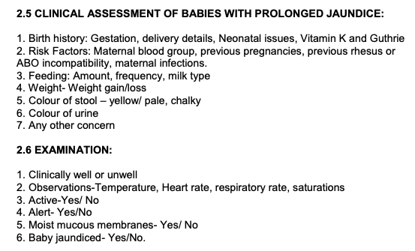
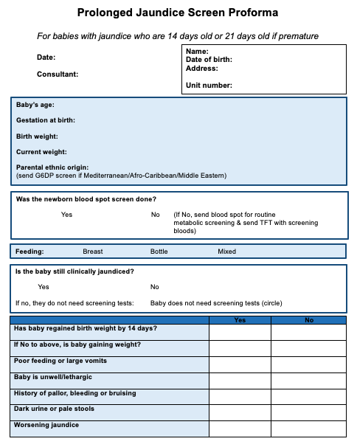
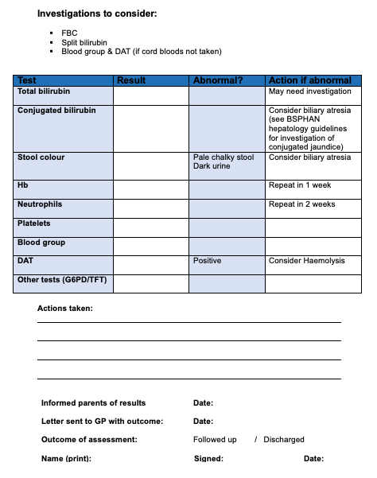
Prolonged jaundice in Guernsey: Developing a proforma for rapid identification, investigation and management
Rebecca H Clough¹, Clare Betteridge ²
¹ University of Leicester, UK
² Medical Specialist Group, Guernsey, Channel Islands
Introduction
Method
Jaundice is a common presentation in neonates ¹
Prolonged jaundice is defined as jaundice in a neonate who is 14 days old, or 21 days old if they were premature ^{2, 3}
Prolonged jaundice can have pathological causes which need rapid identification and management ^{2, 3}
Pathological and serious causes of prolonged jaundice include biliary atresia, congenital hypothyroidism and inherited metabolic disorders ³
The Paediatric department in Princess Elizabeth Hospital (PEH), Guernsey, did not have a screening proforma for prolonged jaundice and felt it would be of benefit
The benefits and plan for a prolonged jaundice screening proforma ^{1,4} were discussed with a Paediatric consultant at the PEH
Recommendations for identification, investigation and management of prolonged jaundice from NICE ² and the British Society of Paediatric Gastroenterology, Hepatology and Nutrition (BSPGHAN) ³ were considered
‘Prolonged jaundice’ and ‘form’, ‘proforma’ or ‘guideline’ were inputted into Google to handsearch available guidelines from a range of UK trusts for evaluation
No guidelines were found from other UK island trusts despite targeted searches
After evaluation of the recommendations and available trust guidelines, a proforma which was relevant to the Guernsey population and hospital was developed
A)
B)
C)
Figure 1: Examples of most relevant proformas found through internet hand searching. A, Page 1 of 2 of proforma from Brighton and Sussex NHS trust; B, Proforma from Whittington NHS trust; C, Proforma from Bristol and Weston NHS trust; D, Proforma from NHS Lothian; E, 2 parts of University Hospitals of Leicester NHS trust prolonged jaundice guideline. All accessed through publicly available internet pages on 23/05/23.
D)
E)
Evaluation
The proformas above from a variety of NHS trusts follow a similar structure and may have been made using the guidelines which set out best practice guidelines released from NICE ² and the BSPGHAN ³
Proformas A, B and D provide a clear flow chart for the identification of neonates with jaundice
Proformas A and C cover a thorough history but are for use in the community
E gives lists of investigations to consider but has not followed a proforma format which would help with documentation
Proforma A matched the requirements of the department, including a flow chart proforma and use of criteria set out by the BSPGHAN for the history and investigations to consider, in addition to actions
Proforma A was used as a template for the new proforma, but alterations were made to make it relevant for use in hospital and to work in a system with no junior doctors, as is the case in the PEH
The proforma will provide staff with a tool to rapidly extract pertinent points in the history and document this easily, in addition to providing a clear pathway for investigation and management of prolonged jaundice
Figure 2: New prolonged jaundice proforma made for the Paediatric department at the PEH, pages 1 and 2 of 2.
References
Jacob Z, Khan S. G331(P) Are we missing pathological causes of prolonged jaundice by streamlining our investigations? Archives of Disease in Childhood 2020;105:A120
Jaundice in newborn babies under 28 days. Clinical guideline [CG98]. Published: 19 May 2010.. https://www.nice.org.uk/guidance/cg98
Investigation of Neonatal Conjugated Jaundice. Liver Steering Group BSPGHAN, 2012
Kirk JM. Neonatal jaundice: a critical review of the role and practice of bilirubin analysis. Annals of Clinical Biochemistry. 2008;45(5):452-462. doi:10.1258/acb.2008.008076
rebecca.clough@uhl-tr.nhs.uk
@rebecca_med

