Slide 1
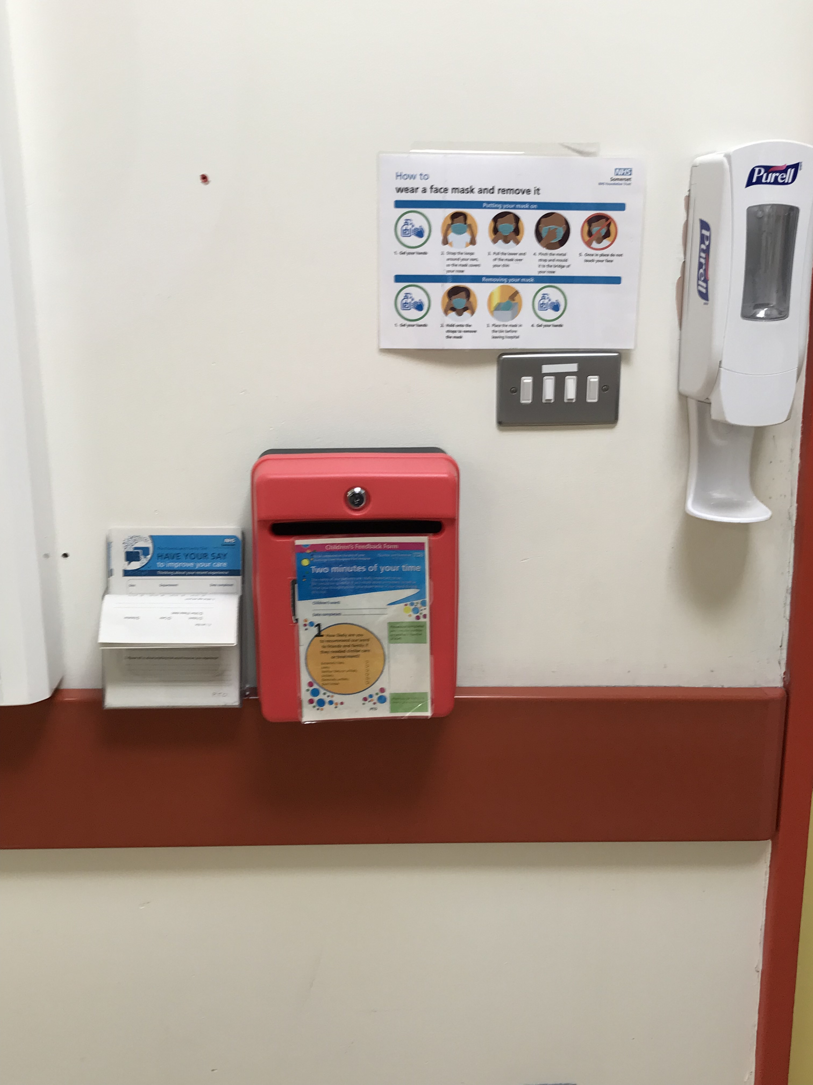
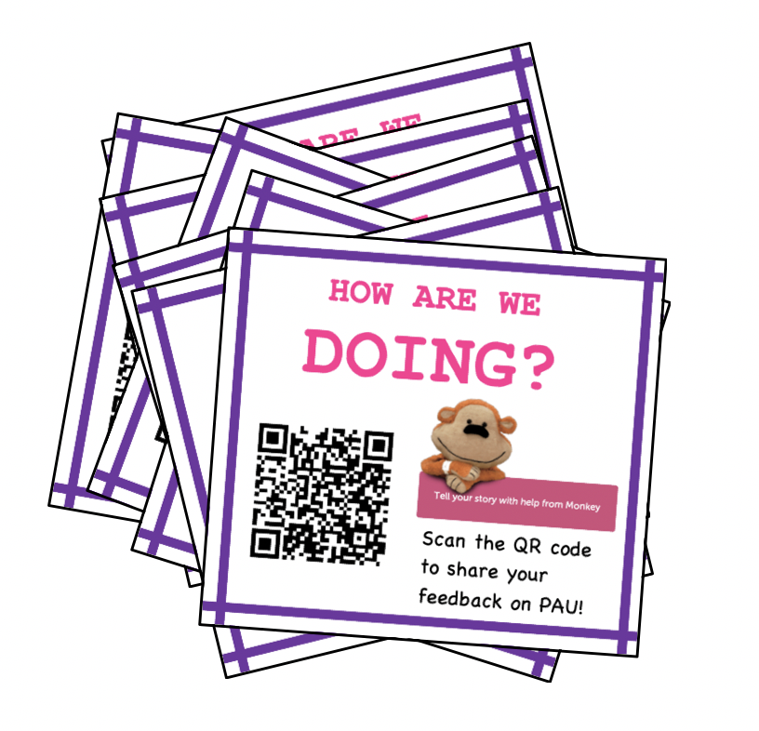
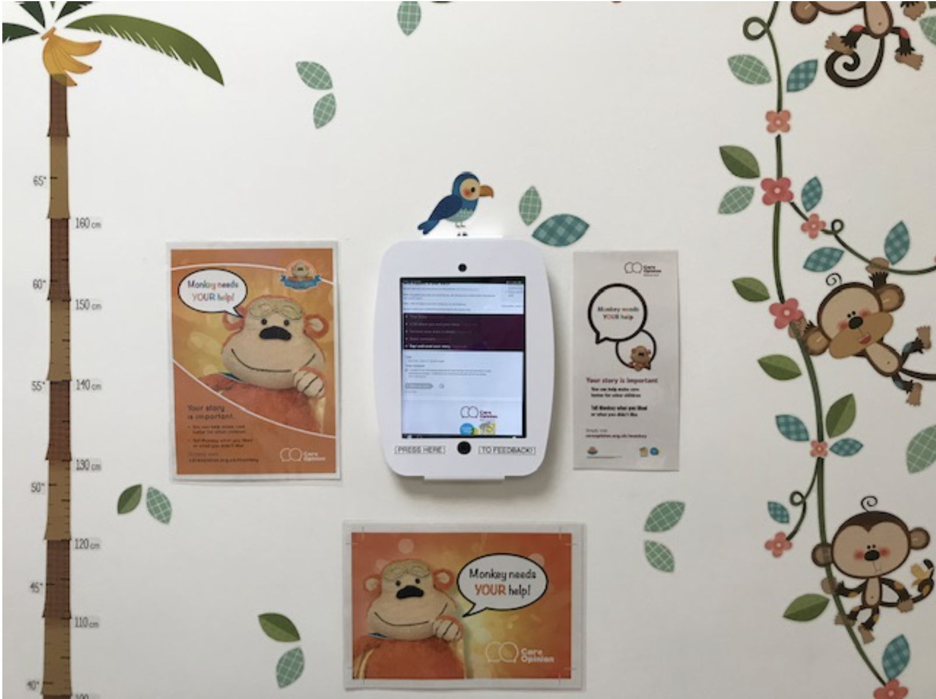
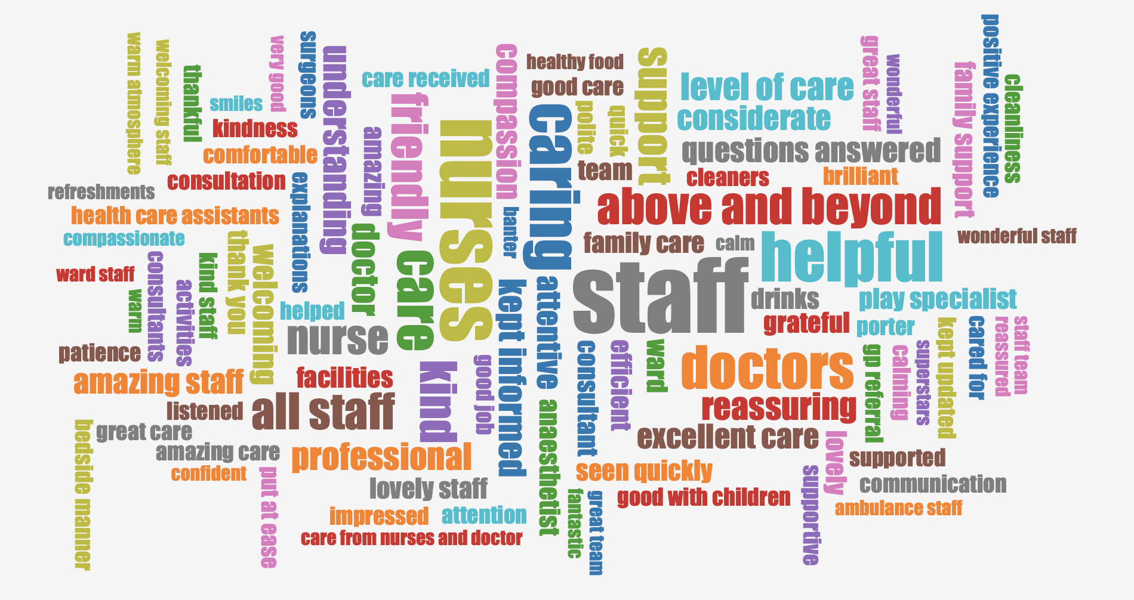
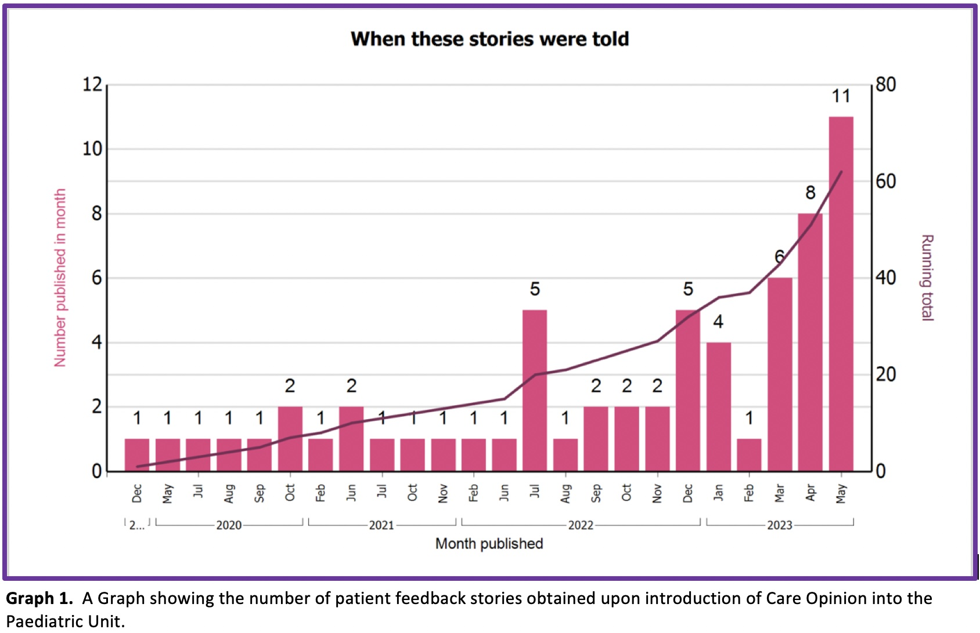
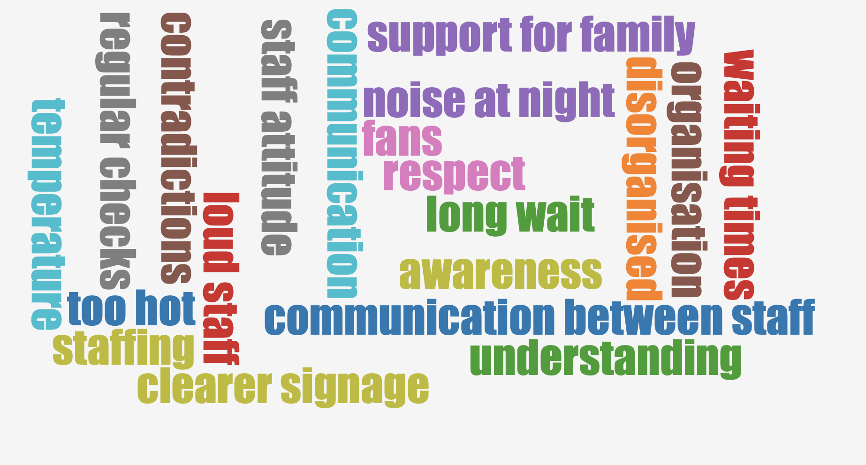
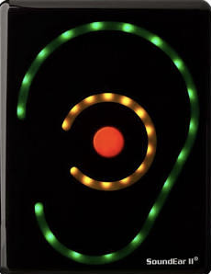
How a Paediatric Unit helped Monkey in his
Quest for Patient & Family Feedback
Dr Holly Mincher (ST4 Paediatric Trainee) & Dr Gita Modgil (Consultant Paediatrician)
Objectives | Understanding patient and family experience is hugely valuable to drive healthcare improvements. Care Opinion, a national open non-profit organisation, provides an online platform for patients to share their experiences of healthcare services. We explored the impacts Care Opinion had on our Paediatric Department.
Methods
Staff Survey
Intervention
Expansion
Oak Wd
+
cOPD
PAU
Acorn Wd
Results Post Intervention
June 2022 - May 2023
Results
 | 8968 Total views | 93% Positive feedback | 21% Of feedback for Somerset FT represented by Paediatrics | 26% Included Cross specialty feedback | 1to2 Days Mean responding time
WHAT’S GOOD
HOW WE CAN IMPROVE
IMPROVEMENTS
SHARING
Staff Huddles
Sound Ear
Certificates
Recognition & thanks
Relaunch
Conclusion | Significant improvement in frequency in feedback responses Majority of patient feedback was positive - the platform allowed prompt acknowledgment and improvements to be made in real-time. Positive impacts went beyond patient care, inc. boosting staff morale and improving cross speciality working relationships. | Shared learning | Strategies to establish and maintain a culture of obtaining feedback Use of promotional strategies to increase patient and family feedback What is important to patients and families when admitted to a paediatric unit and how this is shared to improve patient care.

