Slide 1
Unscheduled, Opportunistic, Multidisciplinary Teaching in the Emergency Department on Common Paediatric Topics.
Dr K Goyder (Paediatric St7)
Dr H Fendley (Emergency Medicine St5)

Slide 2
Paediatric teaching in the ED.
Pre-Hospital staff and The Emergency Department see children on a daily basis.
The availability of paediatric teaching can be variable and the majority of teaching that occurs does not cover common paediatric problems.
Providing planned teaching in the ED is a challenge due to the unpredictable work load.
We developed Flash Mob Teaching to try and provide a solution to these problems. We wanted to make the teaching multidisciplinary to promote a consistent heath message throughout patient journey from paramedic to paediatrics.

Slide 3
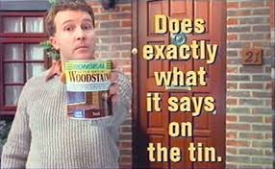
Unscheduled, Opportunistic, Multidisciplinary teaching in the Emergency Department on common paediatric topics.
Flash Mob Teaching

Slide 4
Flash Mob Teaching – how does it work?
Step 1
Take a small (3 – 6 people) group of doctors, nurses, paramedics and ancillary staff of all grades, leaving the department staffed.
Step 2
Deliver a ten minute teaching session with a handout to keep.
Step 3
Swap the teaching group with another small group.
A “teacher” makes a free time slot during the working day or night…
The cycle can be repeated until everyone available is taught, or the teacher is required elsewhere.

Slide 5
What has been achieved so far?
I did a small Pilot in 2015 of this style of teaching which received a good response.
In March 2016 we started FMT in Poole ED, it is still ongoing.
12 sessions were delivered over 6 months, 111 staff members, from 18 different job roles, attended between 1 and 3 session each.
Covering the following topics
Croup
Viral Induced Wheeze
Bronchiolitis
Febrile convulsions
Rashes
Gastroenteritis
Vomiting (not gastroenteritis)

Slide 6
The Multidisciplinary Team
ED Consultants
GPVTS
Deputy Sisters
Ambulance Technicians
Paramedic Students
ED Registrars
Staff Nurses
Work Experience
ECA’s
Nursing Students
ED SHO’s
HCA’s
Sisters
F2
ANP’s & ENP’s
Medical Students
ED Clinical Fellows
Paramedics

Slide 7
What has been achieved by FMT so far?
Multidisciplinary Teaching
Varying Experience levels

Slide 8
Survey of Attendees
Observationally the teaching appeared useful, however we wanted some quantitative data.
We kept attendance data and we surveyed the attendees from the teaching sessions with a 24% response.
We wanted to find out:
Is paediatric teaching needed?
Was FMT meeting individual learning needs?
Ideas for improvement and sustainability?

Slide 9
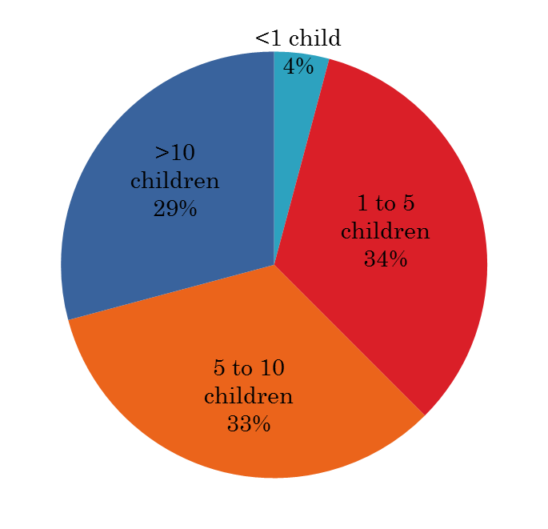
Is paediatric teaching needed in the ED?
How many children do you see per shift?
Paramedics and ED staff see multiple children each shift.

Slide 10
Is paediatric teaching needed in the ED?
How often do you get paediatric Teaching?
What type of Paediatric Teaching do you get?
There is not much Paediatric Teaching going on
Most of the teaching that does happen is mandatory updates:
- EPLS
- APLS
- PILs
- Safe Guarding

Slide 11
Feedback on FMT

Slide 12
More of them
I enjoyed it even though it was in the middle of my night shift
Was actually really good on night shift as slightly less busy
Comments
I inadvertently joined a group early one morning and loved it - any training is helpful
It would be useful to display the hand out somewhere for a while to refer back to when applying the theory to practice :)
the sessions are - bright, positive, focused - even half way through my 4th night shift.....

Slide 13
Can you recall a learning point from a FMT session?
Looking for differential diagnosis of gastroenteritis
Febrile convulsions, it usually only happens with a sudden increase in body temperature. There are 2 types of febrile convulsions.
Red flags in Gastroenteritis
I am better with children's rashes in triage
A vomiting child can be discharged from ED if they are not showing signs of dehydration and parents can safely continue a fluid trials and return of the child becomes dehydrated
Not all febrile convulsions need admission

Slide 14
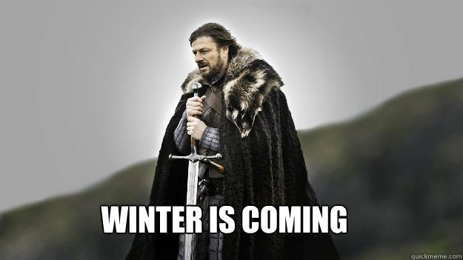
Moving forwards –sustainability and improvements.
As we all know…

Slide 15
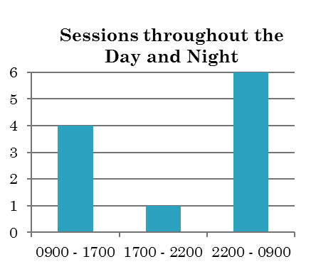
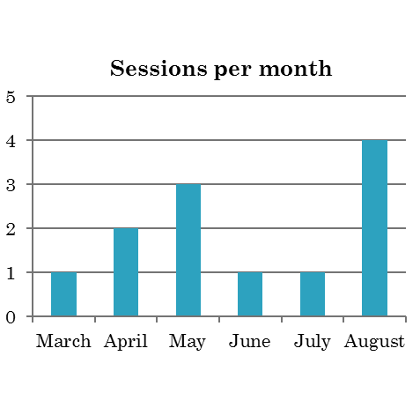
Moving forwards –sustainability and improvements.
Seasonal pressures will affect teaching. We have to plan to counter this;
More teachers through
ED staff now value the sessions and make more effort to attend.
Continue with Night Shift teaching which is well liked.
More accessible handouts.

Slide 16
Summary of Flash Mob Teaching
FMT has provided multidisciplinary teaching that is relevant to all professions of all experience levels.
It has been provided in a busy ED while leaving the floor staffed.
I hope this is a sustainable idea which improves the management of common paediatric problems in ED. With its multidisciplinary focus provides a consistent health message for parents.

Slide 17
Any Questions
(or ideas!)
most welcome.

